Slide 1
Intro to Deep Learning

Slide 2
Let’s discuss Deep Learning
Artificial Neural Network
Neuron
Input, Hidden, Output layers (Forward Propagation)
Backpropagation
Gradient Descent and its variants
Loss function
FC Neural Network(s) - (in Keras)
Convolutional Neural Network(s) (in Keras)
Overfitting, Underfitting and other phenomena in DL

Slide 3
Motivation #1
So, what exactly is deep learning ?
And, why is it generally better than other methods on image, speech and certain other types of data?
‘Deep Learning’ means using a neural network with several layers of nodes between input and output
The series of layers between input & output do feature identification and processing in a series of stages, just as our brains seem to

Slide 4
Motivation #2
DL has become one of the hottest fields in the current day and became very popular!
Eventually, it is very easy to implement DL today, as there are many frameworks - PyTorch, Tensorflow (with Keras), Simply NumPy, etc.
Just implementing this without knowing the concepts is like playing with a black box - you know it’s working, you don’t know how!
Whether it’s for your own usage, industry / academia, you will be tweaking, changing, building DL models, so you should definitely be aware of what’s going on, as much as possible, including the math.
In this course, we’ll dive into Neural Networks by providing step by step explanation, so you’ll be able to grasp it.

Slide 5
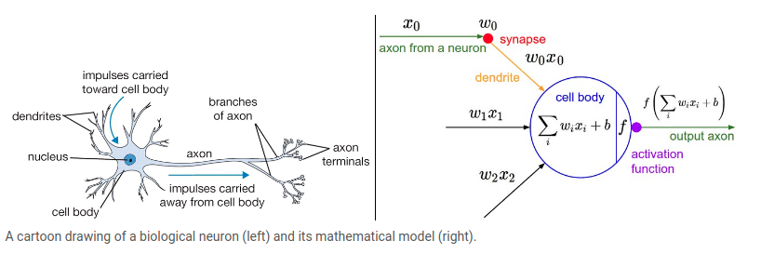
What is a Neuron?
(hint: gets input, does magic, produces output)
Source: CS231n
As can be seen, a neuron is a function which gets inputs from several “axon’s & synapse’s”, aggregates it (SUM in this case), and produces another output, which is being used by the neuron after (as an input). It is working serially

Slide 6
So, eventually - Neuron = Aggregation of data!
The base notation stands behind the fact that a neuron is a function, which:
gets some data
Does a manipulation on top of it
Outputs data that will represent in some way the input
The basic notation works has some “high-school math” ideas. That is:
Z = w0 + x1 * w1 + x2 * w2 + … + xn * wn

Slide 7
Let’s see an example of that “function”
A | B | AND
0 | 0 | 0
0 | 1 | 0
1 | 0 | 0
1 | 1 | 1
Given inputs A, B, we want to perform some aggregation so we will “collect” all of the signals from them. A slightly simple example can be:
def and_neuron(a, b):
w0 = -0.5
w1 = 0.6
w2 = 0.4
z = w0 + w1 * a + w2 * b // -0.5 + 0.6*a + 0.4*b
thresh = lambda x: 1 if x>= 0.5 else 0 // what if we use different things?
r = thresh(z)
print(r)

Slide 8
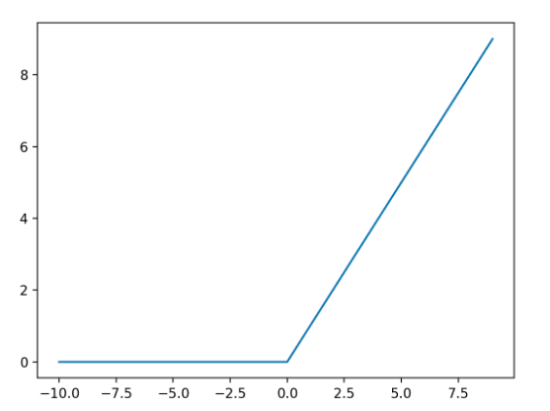
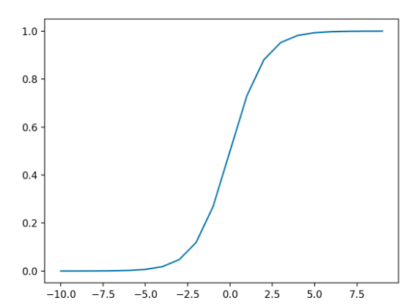
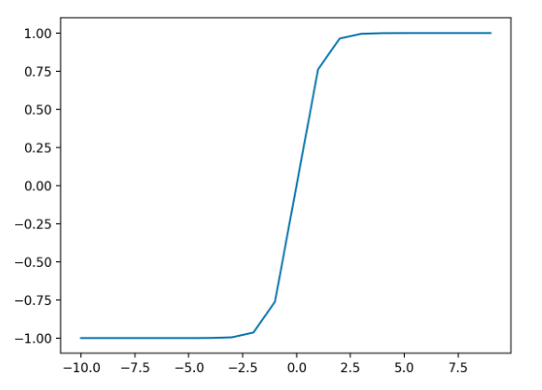
Activation Functions
Activation functions are a critical part of the design of a neural network.
The choice of activation function in the hidden layer will control how well the network model learns the training dataset.
The choice of activation function in the output layer will define the type of predictions the model can make.
As such, a careful choice of activation function must be made for each deep learning neural network project.
Relu
Sigmoid
Hyperbolic Tan

Slide 9
Class Ex. 1
Let’s practice coding in NumPy!
The goal is as follows:
Code a neuron which will implement the above, and will try out the relevant Activation Functions we’ve been going through
Folder Name: Deep Learning
Notebook Name: NumPy_NN.ipynb
Good Luck!

Slide 10
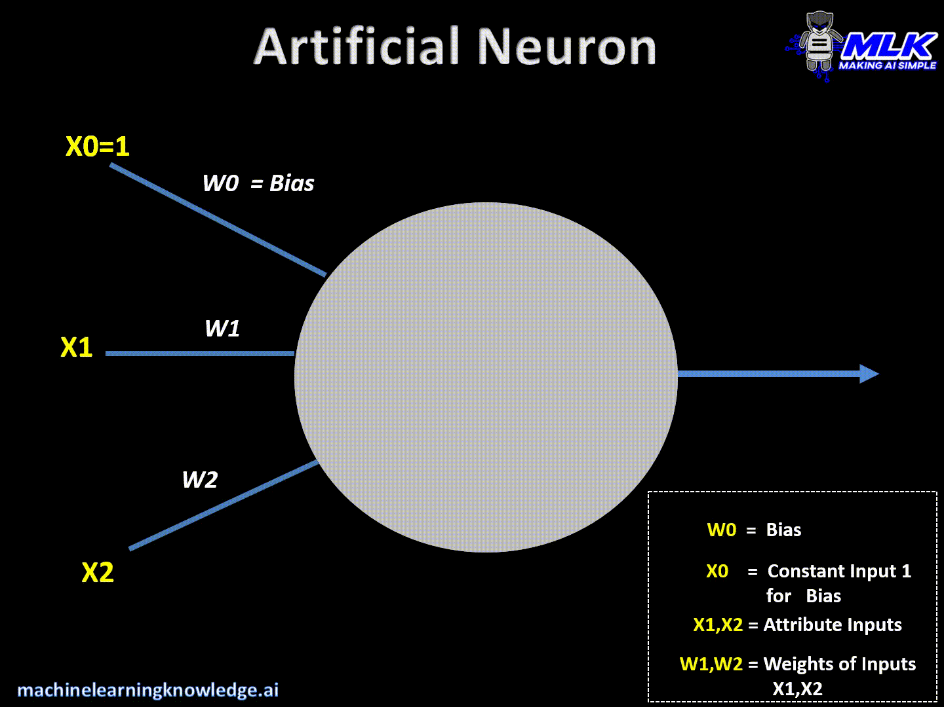
Wrap up Forward Pass - Full Example

Slide 11
Q&A Time

Slide 12
Different layers, Same network
Elements of a Neural Network
Input Layer
This layer accepts input features.
It provides information from the outer world to the network, no computation is performed at this layer, nodes here just pass on the information(features) to the hidden layer.
Hidden Layer
Nodes of this layer are not exposed to the outer world, they are the part of the abstraction provided by any neural network.
Hidden layer performs all sort of computation on the features entered through the input layer and transfer the result to the output layer.
Output Layer
This layer bring up the information learned by the network to the outer world.

Slide 13
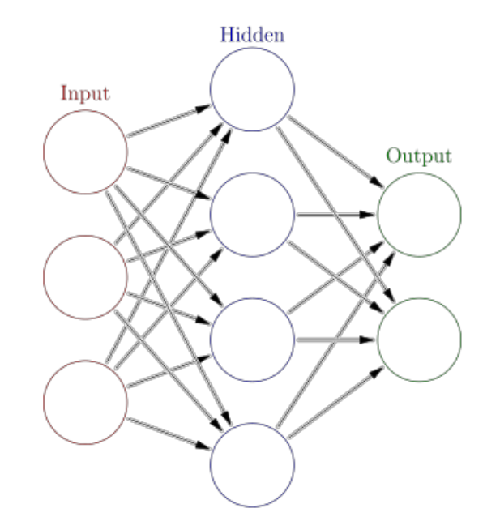
Different layers, Same network

Slide 14
Backpropagation - How the network is learning
Backpropagation is a way of computing gradients of expressions through recursive application of chain rule.
Understanding of this process and its subtleties is critical for you to understand, and effectively develop, design and debug neural networks.
This is the way a Neural Network is actually learning!
Problem statement. The core problem studied is as follows: We are given some function f(x) where x is a vector of inputs and we are interested in computing the gradient of f at x (i.e. ∇f(x)).
Why gradients?

Slide 15
Backpropagation
An example:
Given f(x1, x2) = x1*x2, we want to model the data so our model will be able to learn
X1 = a, x2 = b, how to update x1 and x2 to make f(x, y) more accurate (w.r.t our loss function)?
Follow Gradient Directions!
f(x1, x2) = x1*x2 => derivF / derivX1 = X2,
derivF / derivX2 = X1
X1 = a + 0.01*b
X2 = b + 0.01*a
f(x1, x2) = a*b => (a + 0.01*b)(b + 0.01*a) // a = 4, b = -3
= 4 * (-3) => 3.97 * -2.96 => -11.7512

Slide 16
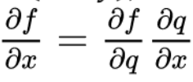
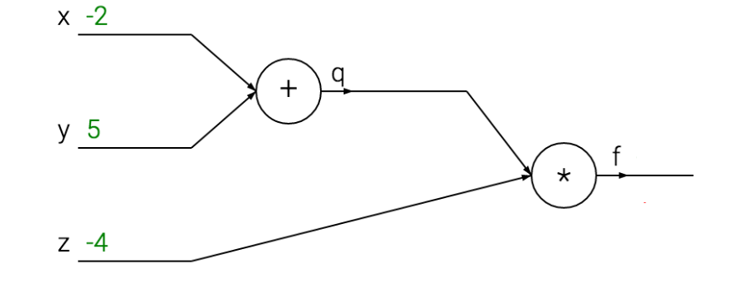
Backpropagation
A more complicated example:
f(x, y, z) = (x + y) * z
q(x, y) = (x + y) => f(x, y, z) = q(x, y) * z
Using the chain rule:

Slide 17
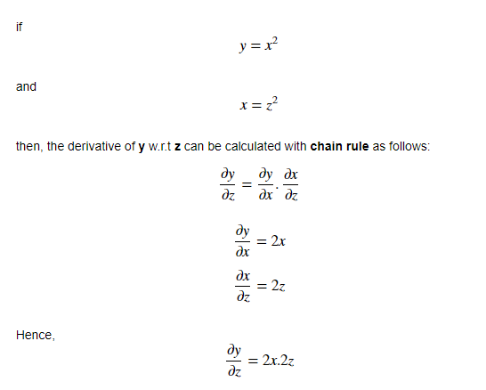
Another Chain-Rule example
(source)

Slide 18
Gradient Descent
Gradient descent is an optimization algorithm that's used when training a machine learning model.
It's based on a convex function and tweaks its parameters iteratively to minimize a given function to its local minimum.
Gradient descent is a way to minimize an objective function (our loss function)
Minimizing our loss function => increasing our model’s accuracy => learning!
A gradient simply measures the change in all weights with regard to the change in error. You can also think of a gradient as the slope of a function.
In mathematical terms, a gradient is a partial derivative with respect to its inputs.

Slide 19
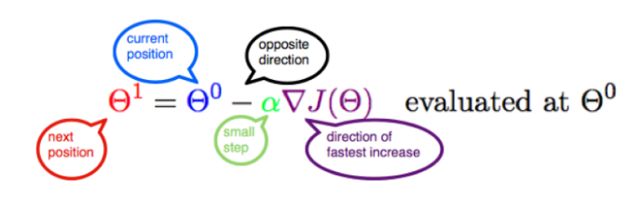
Gradient Descent
To minimize the function, we can instead follow the negative of the gradient, and thus go in the direction of steepest descent. This is gradient descent. Formally, if we start at a point x0, and move a positive distance alpha in the direction of the negative gradient, then our new and improved x_1 will look like this:
A cool post about the math behind Gradient Descent
(Source)

Slide 20
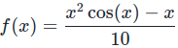
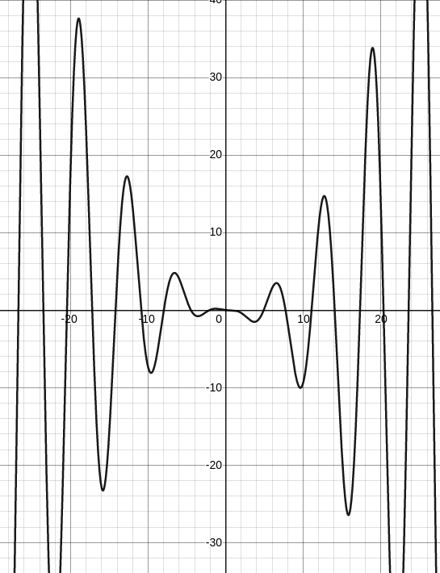
Gradient Descent
Starting from an initial guess x0, we keep improving little by little until we find a local minimum. This process may take thousands of iterations, so we typically implement gradient descent with a computer. Given the below function:

Slide 21
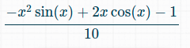
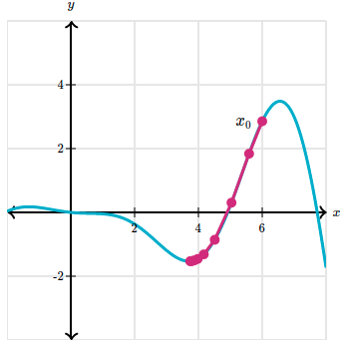
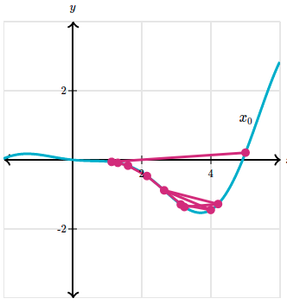
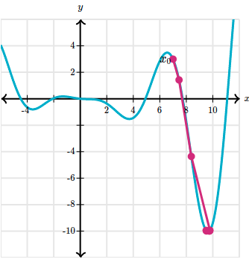
Gradient Descent
f’(x) =
X0 = 6, alpha = 0.2
X0 = 6, alpha = 1.5
X0 = 7, alpha = 0.2
Derivative from here

Slide 22
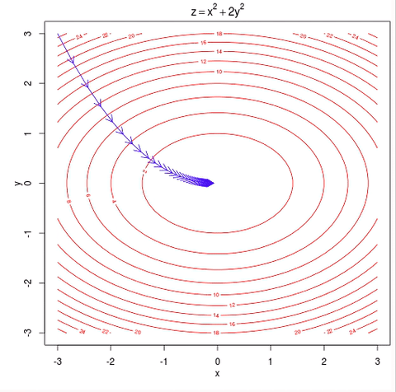
Gradient Descent

Slide 23
Some resources about Backprop and Gradient Descent
See this post with very clear examples
Also, a nice video visually explaining it

Slide 24
Loss Functions
Q: Why do we need a loss function?
A: So that we will be able to measure the model against the reality, plus we will be able to present some results to anyone interested! (e.g. train error was X, test error was 0.5X...)
As part of the optimization algorithm, the error for the current state of the model must be estimated repeatedly.
This requires the choice of an error function, conventionally called a loss function, that can be used to estimate the loss of the model so that the weights can be updated to reduce the loss on the next evaluation.

Slide 25
Loss Functions - the main ones
Regression | Classification
MSE | Binary Cross Entropy
MAE | Hinge Loss

Slide 26
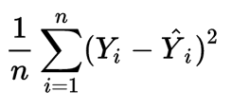
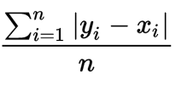
Loss Functions - the main ones
Regression
MSE (Mean Squared Error) MAE (Mean Absolute Error)
Prediction (Y^) | Label (Y) | MAE
1 | 2 | (|1-2| + |2-4| + |3-3|)/3 = 1
2 | 4 | MSE
3 | 3 | ((1-2)^2 + (2-4)^2 + (3-3)^2)/3 = 1.67

Slide 27
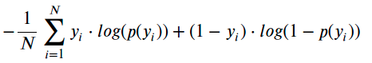
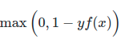
Loss Functions - the main ones
Classification
Binary Cross Entropy (Log-loss) Hinge Loss
P(Y^) | Y | BCE
0.95 | 1 | -⅓ * [(1 * log(0.95)) + (1 * log(0.35)) + (0 * log(0.03))] = -⅓ * [-0.02 -0.45] = 0.15
0.35 | 1 | Hinge Loss
0.03 | 0 | max(0, 1-0*0.03) = 1 + max(0, 1-1*0.35) = 0.65 + max(0, 1-1*0.95) = 0.05 = 1.7

Slide 28
First Neural Network - Ex. 2
Ex. 2 is called - First_Neural_Network.ipynb

Slide 29
Summing it all together
into a Fully Connected Neural Network
Now that we have the main components, we can compose
a fully connected neural network
A Neuron is needed in order to perform computation on inputs
A Layer is a set of neurons
(Forward Pass) Input layer gets inputs from the data we have
(Forward Pass) Hidden layer(s) gets inputs from the input layer and passes it onto the output layer
(Forward Pass) Output layer gets inputs from the hidden layer(s) and passes it onto the loss function
Loss function computes loss based on y^ and y (prediction and label)
Backpropagation algorithm, using Gradient Descent, comes in place in order to update the weights and to learn
Iteratively 1-7 again and again until convergence...
And there you go - the pseudo code of a Neural Network!

Slide 30
Q&A Time

Slide 31
Fully Connected Neural Networks
As you saw in the Ex.2, if we want a larger network, we will need to think about each function’s derivative, derivative it accordingly, and populate the input forward and backward, again and again, playing with a lot of parameters, and inputs.
This is not scalable, of course.
Luckily, we have python libraries who does this for us behind the scenes.
Now you are going to meet Keras, and eventually you’ll get familiar with this library, which will make it pretty easy to build up a NN
Fun time! Let’s practice Fully connected NNs without coding (Let’s take ~15-20 min for this)

Slide 32
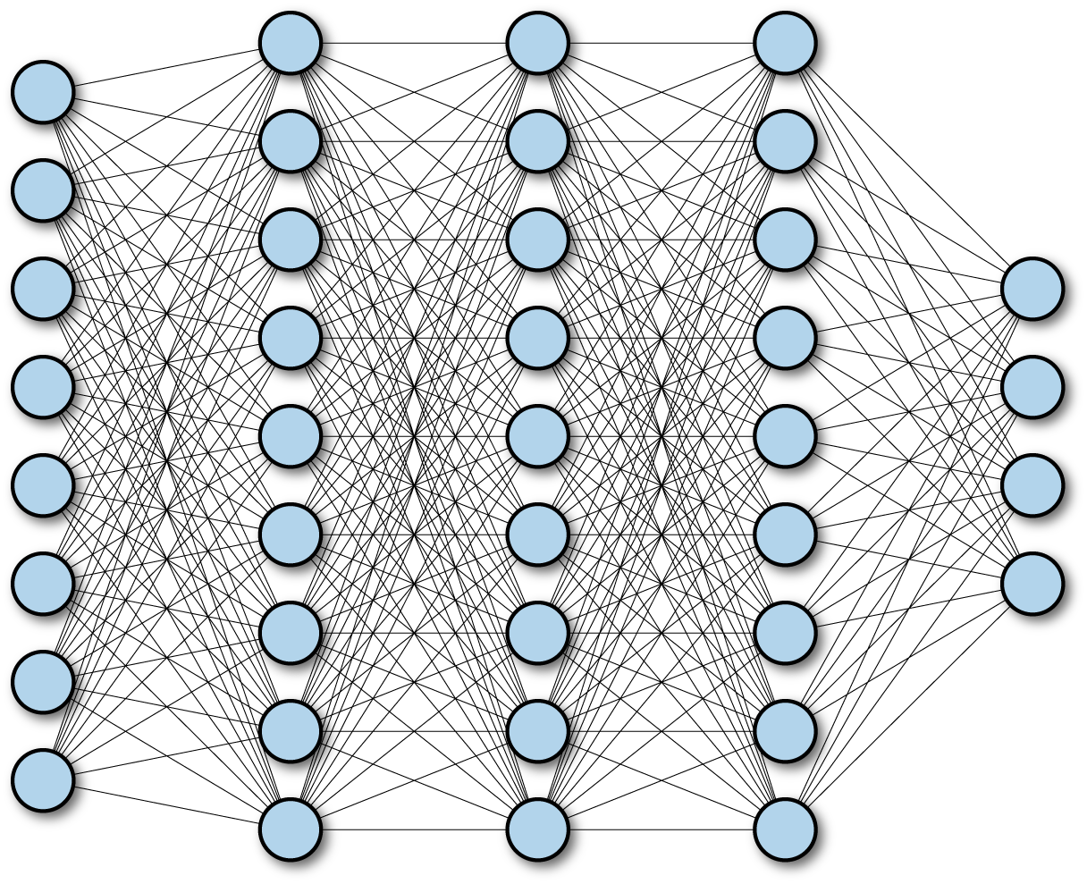
Fully Connected Neural Networks

Slide 33
Fully Connected Neural Networks
A fully connected Neural Network is a network composed from many neurons, and many layers!
Meaning:
There is not only 1-d input (or 2-d…)
There is not only 1 hidden layer
There is 1 output layer which can be composed of >1-d
“One of the main advantages of deep learning lies in being able to solve complex problems that require discovering hidden patterns in the data and/or a deep understanding of intricate relationships between a large number of interdependent variables.” (source)

Slide 34
Fully Connected Neural Networks - Ex. 3
Keras API - get familiar with this powerful API for building Neural Networks
Folder Name: Deep Learning
Ex. 3 is called “DL_in_Keras_Ex3.ipynb”
Once done - “Raise Hand” over chat

Slide 35
Exercises Solutions - Ex. 1 to Ex. 3

Slide 36
Convolutional Neural Networks
A Convolutional Neural Network, also known as CNN or ConvNet, is a class of neural networks that specializes in processing data that has a grid-like topology, such as an image.
A digital image is a binary representation of visual data.
It contains a series of pixels arranged in a grid-like fashion that contains pixel values to denote how bright and what color each pixel should be.

Slide 37
Convolutional Neural Networks
Motivation: why do we need CNN?
As we previously saw, FC NN usually receive an input (a vector), and transform it through a series of hidden layers.
Each hidden layer is made up of a “bunch” of neurons, and each neuron is fully connected to all neurons in the previous layer.
Regular Neural Networks don’t scale well to full images, and why is that?
Let’s think of CIFAR-10 (images of 32x32x3) - A single fully-connected neuron in a first hidden layer of a regular Neural Network would need to be 32*32*3 = 3072 weights.
This seems cool up till here, but what would be the case if the image was 200*200*3 ? => 120,000 weights! This scales largely pretty easily, and can lead to bad phenomena such as overfitting, and just way more computation than actually needed

Slide 38
Convolutional Neural Networks
Fully Connected Neural Network | Convolutional Neural Network
Uses Fully Connected Layers (as we saw) | Uses Partially Connected Layers
Can be used only for small images | Can be used for any image
Considers entire image for learning the image “patterns” | Considers only the part of an image, aka Receptive Field
# of parameters will be very high. E.g. for 28x28 images, if a layer has 32 neurons, the # of params will be 28x28x32 = 25,088. Consequently, computations per each of these values | # of parameters will be very less compared to FCNN. For 28x28 image, if the layer has 32 filters (we’ll learn soon), each filter size = 5 (we’ll learn soon), num of parameters will be (5*5*1 + 1) * 32 = 832. Computations accordingly
No translation invariant. Once a regular DNN has learned a pattern in one location, it won’t learn to recognize it in other location. In short, we will need to re-train the model | Translation invariant. Once a CNN has learned a pattern in one location, it can recognize it in other location. In short, weights can be reused even if the image is rotated, shifted, etc.

Slide 39
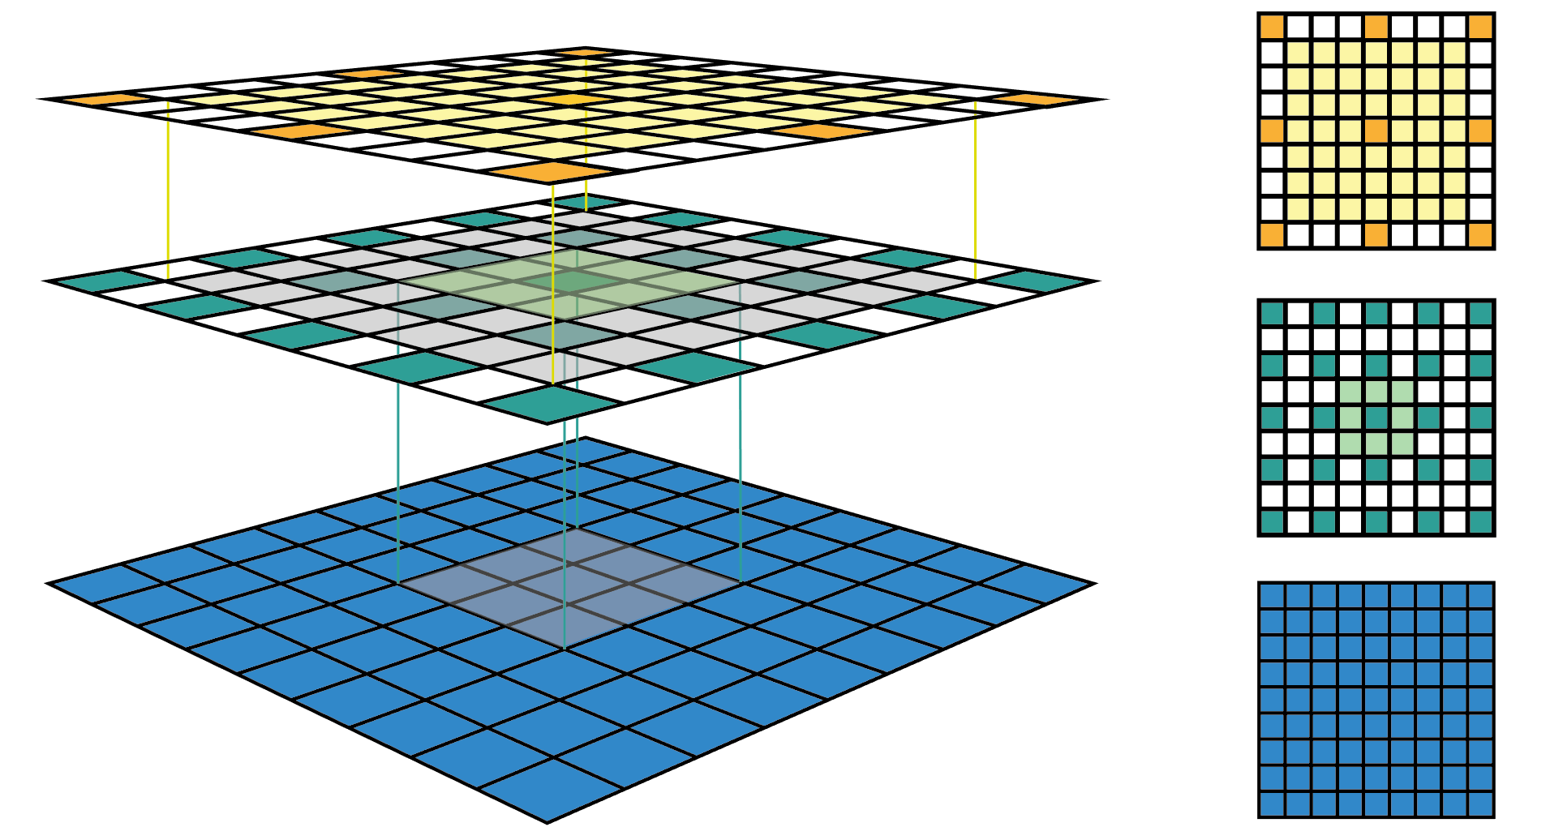
Convolutional Neural Networks
Receptive Field
(The receptive field is defined as the region in the input space that a particular CNN's feature is looking at (i.e. be affected by) . A receptive field of a feature can be described by its center location and its size)

Slide 40
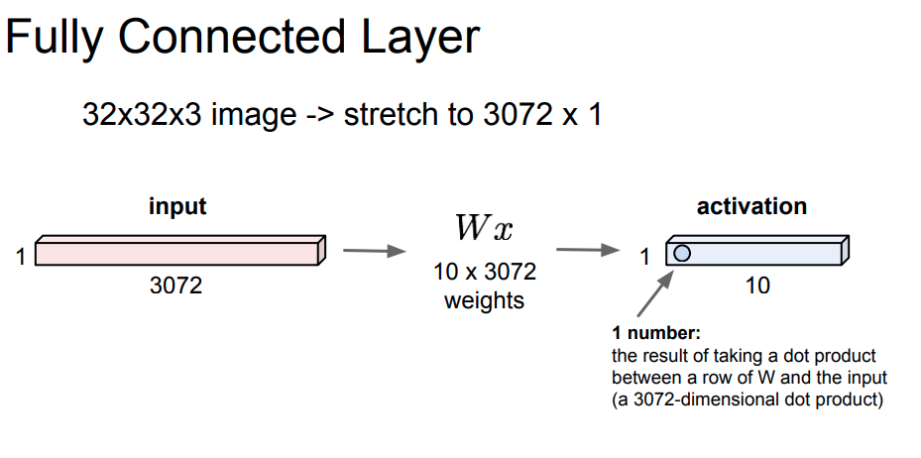
Convolutional Neural Networks
source

Slide 41
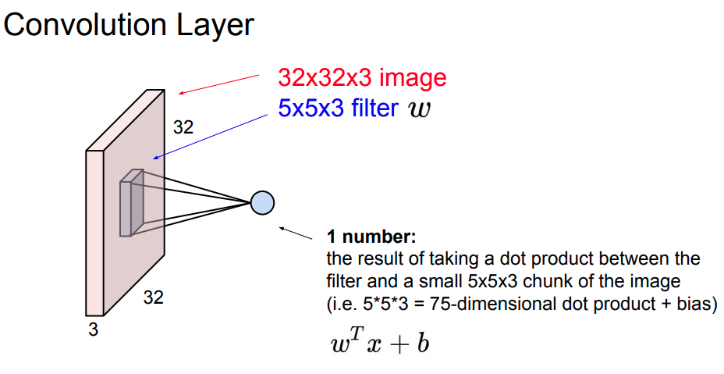
Convolutional Neural Networks
source

Slide 42
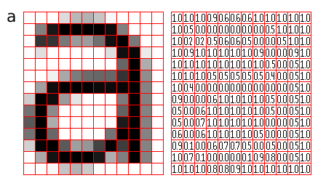
Convolutional Neural Networks
source

Slide 43
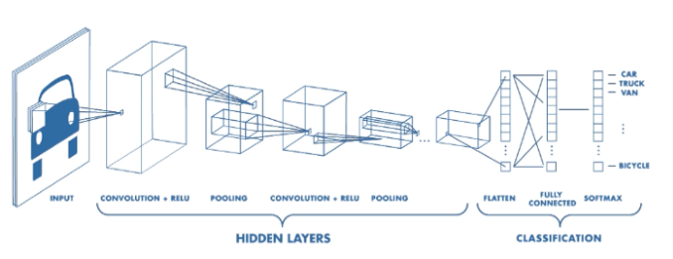
Convolutional Neural Networks

Slide 44

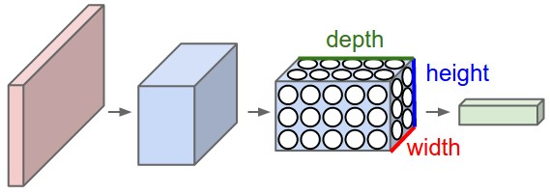
Moving from FC NNs to CNN
From
To
source

Slide 45
Moving from FC NNs to CNN
Similarities
They are both made up of neurons that have learnable weights and biases.
Each neuron receives some inputs, performs a dot product and optionally follows it with a non-linearity.
A loss function still exists and being “learned” and updated via the training process
Differences
ConvNet architectures make the explicit assumption that the inputs are images, which allows us to encode certain properties into the architecture.
These then make the forward function more efficient to implement and vastly reduce the amount of parameters in the network

Slide 46
Moving from FC NNs to CNN
3D volumes of neurons
CNNs take advantage of the fact that the input consists of images and they constrain the architecture in a more sensible way
In particular, unlike a regular Neural Network, the layers of a ConvNet have neurons arranged in 3 dimensions: width, height, depth.
For example, the input images in CIFAR-10 are an input volume of activations, and the volume has dimensions 32x32x3 (width, height, depth respectively, and 3 stands for RGB, color, image).

Slide 47
CNN Layers
A ConvNet (CNN) is a sequence of layers, and every layer of this ConvNet transforms one volume of activations to another through a differentiable function.
As opposed to Neural Networks, here there are several types of layers.
We use three main types of layers to build ConvNet architectures:
Convolutional Layer
Pooling Layer
Fully-Connected Layer (exactly as seen in regular Neural Networks)
Now we’ll dive into each of them in order to understand:
What’s going in
What’s being done
What’s going out

Slide 48
Convolutional Layer
The Convolutional layer is the core building block of a CNN, and basically it does most of the computational heavy lifting.
Main Attributes:
The CONV layer parameters consist of a set of learnable filters
Every filter is small in terms of w, h, but extends through the full depth of the input volume. For example, a typical filter on a first layer of a ConvNet might have size 5x5x3 (i.e. 5 pixels width and height, and 3 because images have depth 3, the color channels)
During the forward pass, we “convolve” each filter across the width and height of the input volume and compute dot products between the entries of the filter and the input at any position
Intuitively, the network will learn filters that activate when they see some type of visual feature such as an edge of some orientation or a blotch of some color on the first layer, or eventually entire honeycomb or wheel-like patterns on higher layers of the network

Slide 49
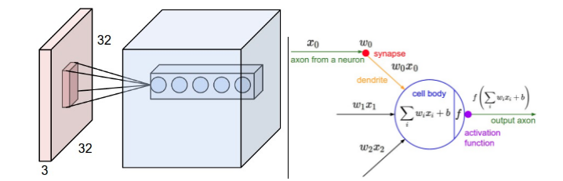
Convolutional Layer
source

Slide 50


Convolutional Layer
source

Slide 51
Convolutional Layer
Class Exercise - Let’s do a math, “by-hand” example.
These are the things that really helps to understand the bits behind this fascinating algo!
Given an image h:
Given a filter f:
We can produce Matrix G
10 | 8 | 10 | 5 | 10 | 0
7 | 12 | 4 | 8 | 10 | 0
4 | 10 | 5 | 8 | 10 | 10
6 | 6 | 6 | 1 | 2 | 10
8 | 5 | 5 | 5 | 2 | 8
9 | 0 | 0 | 0 | 2 | 5
1 | 2 | 1
0 | 0 | 0
-1 | -2 | -1
*
=

Slide 52
Convolutional Layer
Class Exercise - Let’s do a math, “by-hand” example.
These are the things that really helps to understand the bits behind this fascinating algo!
Given an image h:
Given a filter f:
We can produce Matrix G
10 | 8 | 10 | 5 | 10 | 0
7 | 12 | 4 | 8 | 10 | 0
4 | 10 | 5 | 8 | 10 | 10
6 | 6 | 6 | 1 | 2 | 10
8 | 5 | 5 | 5 | 2 | 8
9 | 0 | 0 | 0 | 2 | 5
7 | ... | ... | ...
... | ... | ... | ...
... | ... | ... | ...
... | ... | ... | ...
1 | 2 | 1
0 | 0 | 0
-1 | -2 | -1
*
=

Slide 53
Convolutional Layer
Now it’s your turn!
Given an image h:
Given a filter f:
We can produce Matrix G
10 | 8 | 10 | 5 | 10 | 0
7 | 12 | 4 | 8 | 10 | 0
4 | 10 | 5 | 8 | 10 | 10
6 | 6 | 6 | 1 | 2 | 10
8 | 5 | 5 | 5 | 2 | 8
9 | 0 | 0 | 0 | 2 | 5
7
1 | 2 | 1
0 | 0 | 0
-1 | -2 | -1
*
=

Slide 54
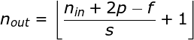
Convolutional Layer
How should we know the size of the new matrix that we generate?
Luckily, someone already developed formulas for this as well :)
N_out = [(N_in + 2p - f)/s + 1]
D_out = num_filters
Where,
N_out = the size of the output w/h (following convolve)
N_in = the size of the input w/h
P = Padding (you’ll see in a bit)
S = Stride (you’ll see in a bit)
F = filter size
Num_filters = number of filters applied on that input (e.g. 64)

Slide 55
Convolutional Layer Parameters
Stride & Padding - what are they all about?
Stride - “our jumps” in which we slide the filter
When the stride is 1 then we move the filters 1 pixel at a time.
When the stride is 2 then the filters jump 2 pixels at a time as we slide them around.
Larger stride will produce smaller output volumes spatially.
Padding - sometimes it will be convenient to pad the input volume with zeros around the border. The size of this zero-padding is a hyperparameter, which eventually decides on the output size (w, h).
Most APIs (Keras, PyTorch, …) support zero padding vs. 1..X padding

Slide 56
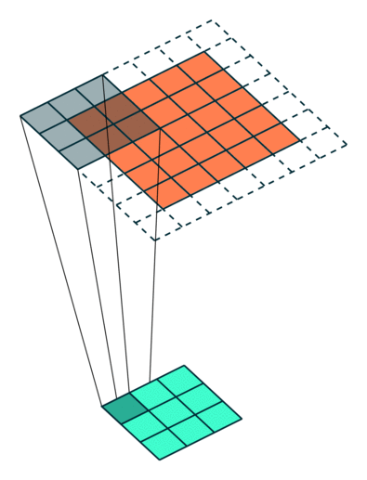
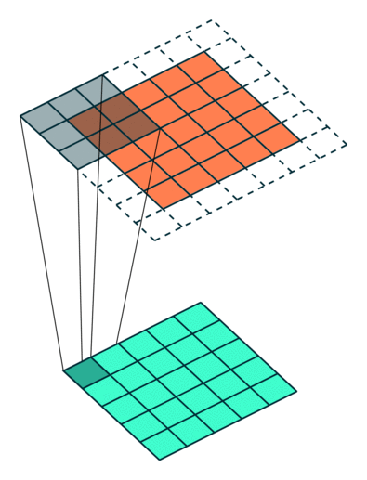
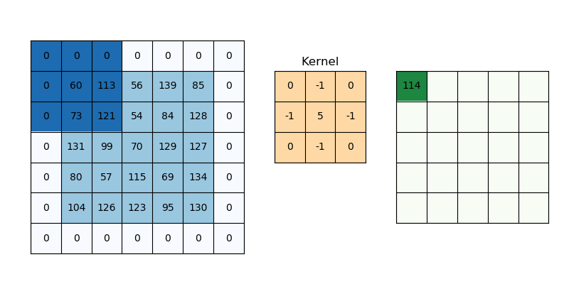
Convolutional Layer Parameters
Let’s see some examples - from here, and here
Stride (s) = 2, Padding (p) = 1
Stride (s) = 1, Padding (p) = 1
Stride (s) = 1, Padding (p) = 1

Slide 57
Pooling Layer
Another crucial layer in CNNs is the pooling layer.
It is common to periodically insert a Pooling layer in-between successive Conv layers in a ConvNet architecture
Its function is to progressively reduce the spatial size of the representation to reduce the amount of parameters and computation in the network, and hence to also control overfitting
The Pooling Layer operates independently on every depth slice of the input and resizes it spatially (by w, h), using the MAX / AVG operation. The most common form is a pooling layer with filters of size 2x2 applied with a stride of 2 downsamples every depth slice in the input by 2 along both width and height, discarding 75% of the activations
Every MAX/AVG operation would in this case be taking a max over 4 numbers (little 2x2 region in some depth slice)
The depth dimension remains unchanged

Slide 58
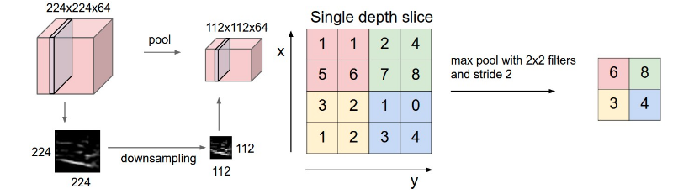
Max Pooling example
Pooling (Max in this case) works as follows:
source

Slide 59
Max Pooling example
Luckily, we can also calculate output sizes following any pooling operation!
Given: W1, H1, D1 (e.g. 28*28*3)
Stride = S = 2, filter_size = F (e.g. 2)
Output will be -
W2 = (W1 - F) / S + 1 →(28 - 2) / 2 + 1 = 13 + 1 = 14
H2 = (H1 - F) / S + 1 →(28 - 2) / 2 + 1 = 13 + 1 = 14
D2 = D1 // meaning -> Pooling does not “touch” the input depth
Output size: 14*14*3
source

Slide 60
Let’s code your first CNN!
Before starting this ex. (and for the next exercise), let’s go over a quick overview of CNN in Keras
Once we’re done,
Folder Name: Deep Learning
Ex. 4 is called “DL_CNN_in_Keras_Ex4.ipynb”
In this ex., you are going to implement your first CNN in Keras!
You will see the different layers of CNN, in Keras, using the Sequential API.
Once done - “Raise Hand” over chat

Slide 61
CNN - Main Architectures
There are many “known” architectures, that were developed by great researchers along the years, and are in usage even today.
This architectures were tested on many datasets, and even on “baseline” datasets, that helps to evaluate how good a model is “overall”.
Now, we’ll go through few of these and will learn how and why are the speciality of each.

Slide 62
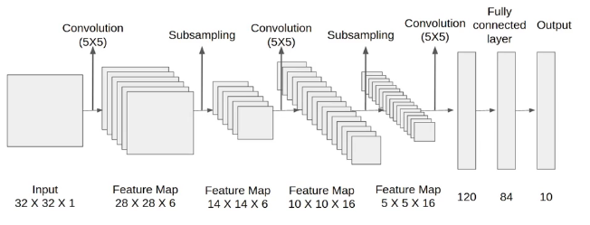
CNN - LeNet-5
Convolutional Filters were 5*5, applied at stride=1 with pooling
layers were 2*2 applied at stride 2
architecture is: [CONV-POOL-CONV-POOL-FC-FC]
Subsampling == Pooling
[LeCun et al., 1998]

Slide 63
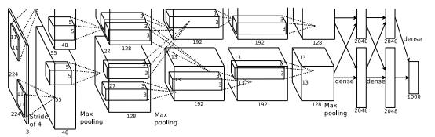
CNN - AlexNet
[227x227x3] INPUT
[55x55x96] CONV1: 96 11x11 filters at stride 4, pad 0
[27x27x96] MAX POOL1: 3x3 filters at stride 2
[27x27x96] NORM1: Normalization layer
[27x27x256] CONV2: 256 5x5 filters at stride 1, pad 2
[13x13x256] MAX POOL2: 3x3 filters at stride 2
[13x13x256] NORM2: Normalization layer
[13x13x384] CONV3: 384 3x3 filters at stride 1, pad 1
[13x13x384] CONV4: 384 3x3 filters at stride 1, pad 1
[13x13x256] CONV5: 256 3x3 filters at stride 1, pad 1
[6x6x256] MAX POOL3: 3x3 filters at stride 2
[4096] FC6: 4096 neurons
[4096] FC7: 4096 neurons
[1000] FC8: 1000 neurons (class scores)
Input: 227x227x3 images
First layer (CONV1): 96 of 11x11 filters applied at stride 4 =>
Q: what is the output volume size?
[Krizhevsky et al., 2012]
55*55*96, and why?
(227-11)/4+1 = 55 -> w = h
C (or depth) = 96 (num of filters)
Notes:
55*55*96

Slide 64
CNN - AlexNet
What was special here?
First use of ReLU!
Used norm layers (not common today)
Historical note: Trained on GTX 580 GPU with only 3 GB of memory.
Network spread across 2 GPUs, half the neurons (feature maps) on each GPU
Was a “baseline” for a more advanced networks (you’ll see in a bit)
[Krizhevsky et al., 2012]
Notes:
55*55*96

Slide 65
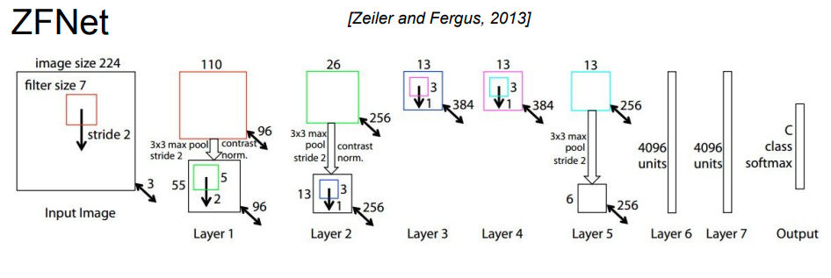
CNN - ZFNet
Actually, pretty similar to AlexNet, but…
CONV1: change from (11x11 stride 4) to (7x7 stride 2)
CONV3,4,5: instead of 384, 384, 256 filters use 512, 1024, 512
[Zeiler and Fergus, 2013]
Notes:
55*55*96

Slide 66
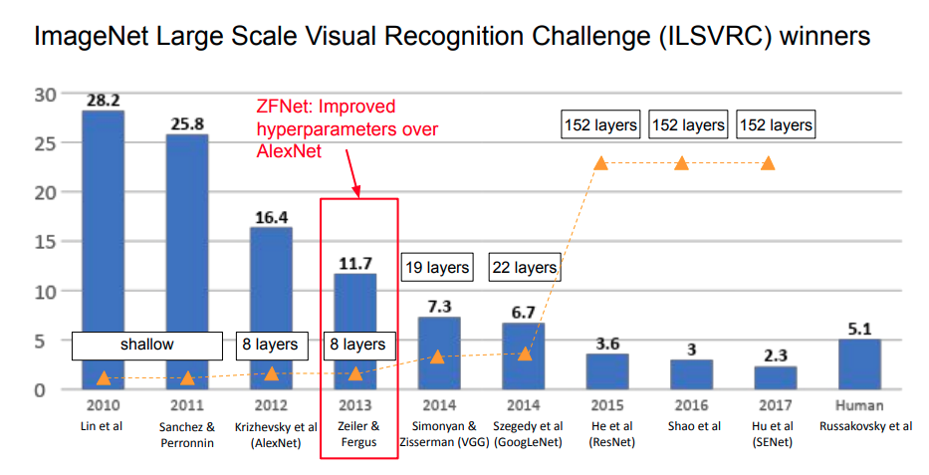
CNN - ZFNet
[Zeiler and Fergus, 2013]
Notes:
55*55*96

Slide 67
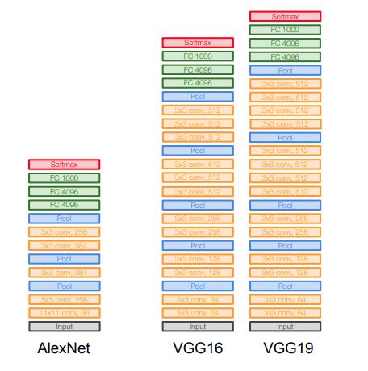
CNN - VGGNet (Very Deep…)
The Key: Small filters, Deeper networks
8 layers (AlexNet)
-> 16 - 19 layers (VGG16Net)
Only 3x3 CONV stride 1, pad 1
and 2x2 MAX POOL stride 2
Results on ImageNet
From the “best” ZFNet score, 11.7% top 5 error in ILSVRC’13, to 7.3% top 5 error in ILSVRC’14 !
[Simonyan and Zisserman, 2014]
Notes:
55*55*96

Slide 68
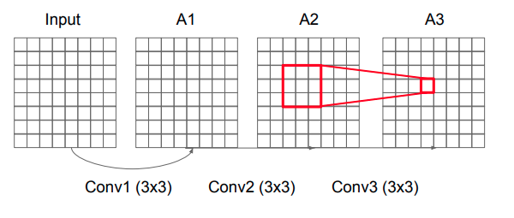
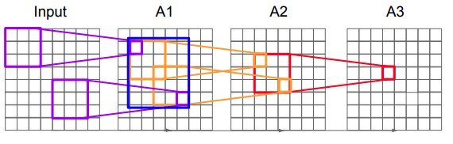
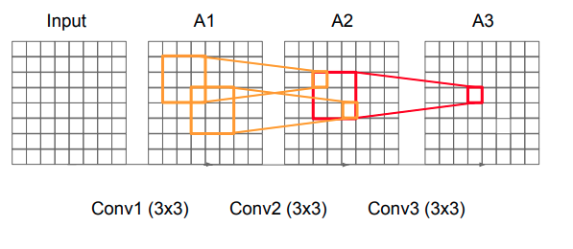
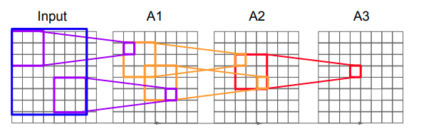
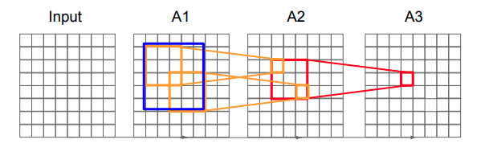
CNN - VGGNet (Very Deep…)
Why use 3 of 3*3 (stack) of filters?
Remember the “Receptive Field” we discussed
Stack of three 3x3 conv (stride 1) layers has same effective receptive field as one 7x7 conv layer, plus we use less parameters:
3 * (3^2*C^2) vs. (7^2C^2) for C channels per layer
source
Notes:
55*55*96

Slide 69
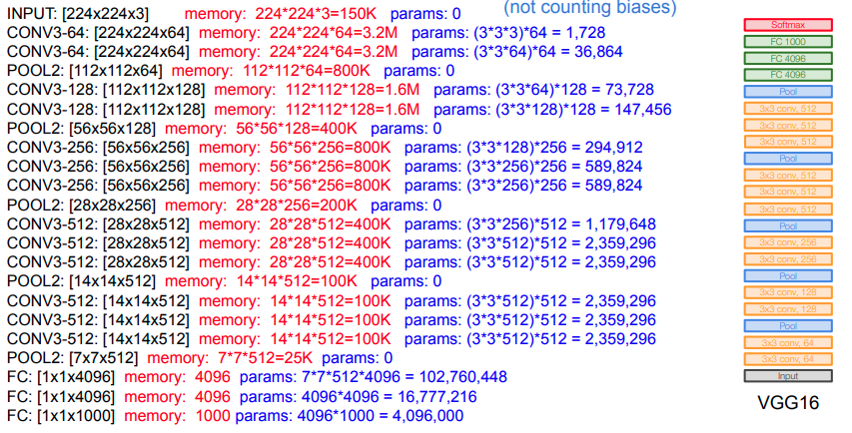
CNN - Let’s talk parameters
source
Notes:
55*55*96

Slide 70
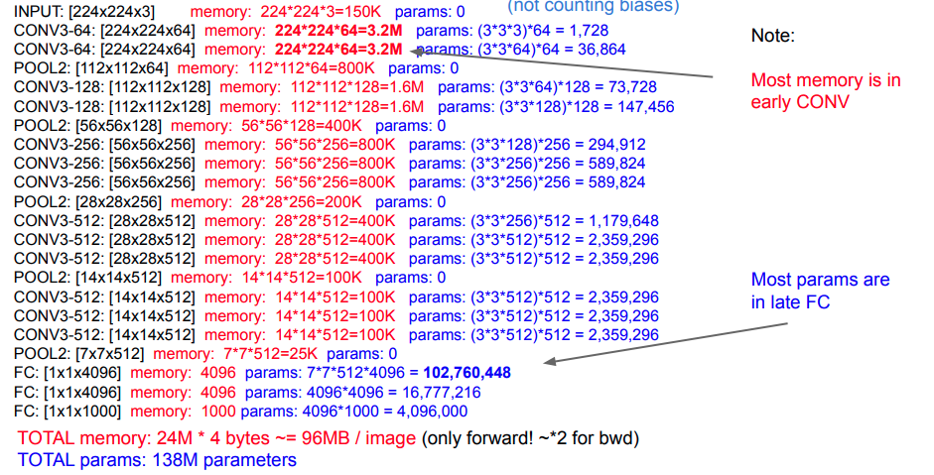
CNN - Let’s talk parameters and memory
source
Notes:
55*55*96

Slide 71
CNN - Competition Time!
Now it’s your time to shine!
You will be given a dataset (MNIST), a specific code for data preprocessing, and your goal is to reach at least 92% accuracy! (on the test set).
You should implement one of the models (LeNet, AlexNet, …) from scratch, OR you can define your own architecture!
Folder Name: Deep Learning
Ex. 5 is called “DL_CNN_Competition_Ex5.ipynb”
Once done - “Raise Hand” over chat

Slide 72
CNN & NN - Let’s test the two of them
Now we are going to have a nice competition, this time not between you and an accuracy.
This time, the competition is between models!
You will be given a dataset (Boston Housing prices), and you will be ask to predict a price using two models - NN and CNN.
You will need to build them, compile them, train them, and evaluate their performance.
At the end, you will need to decide who is better based on the evaluation.
The goal is to be able to see how NNs performs on non-classical problems (e.g. regression problems)
Ex. 6 is called “DL_Ex6_CNN_NN_Competition_on_Regression_Keras.ipynb”
Once done - “Raise Hand” over chat

Slide 73
CNN & NN - A possible solution
A possible solution and walkthrough notebook to Ex. 6 can be found here

Slide 74
Q&A Time

Slide 75
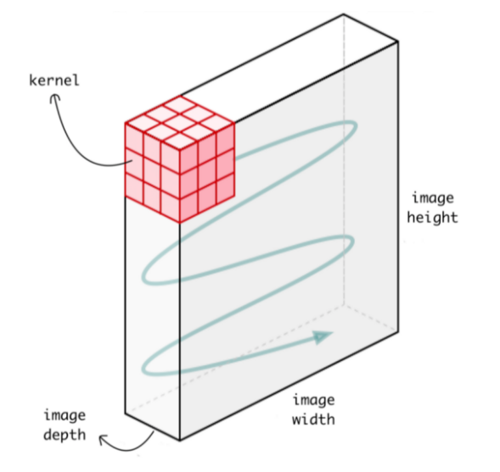
Conv1D, Conv2D
This is something you saw in Ex. 6, so let’s go over what’s Conv1D and what’s is used for. Before that, as a reminder, this is Conv2D: It is called 2 dimensional CNN because the kernel slides along 2 dimensions on the data as shown in the following image:

Slide 76
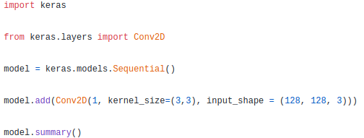
Conv1D, Conv2D
In code, Conv2D looks like this:
input_shape (128, 128, 3) represents the: (height, width, depth) of the image
kernel_size (3, 3) represents (height, width) of the kernel, and kernel depth will be the same as the depth of the image.

Slide 77
Conv1D, Conv2D
Conv1D, on the other hand, is a bit different. In Conv1D, our kernel (filter) slides along one dimension this time.
Relevant data types that can be used for conv1d:
Tabular Data
Time series data (also tabular in a sense)

Slide 78
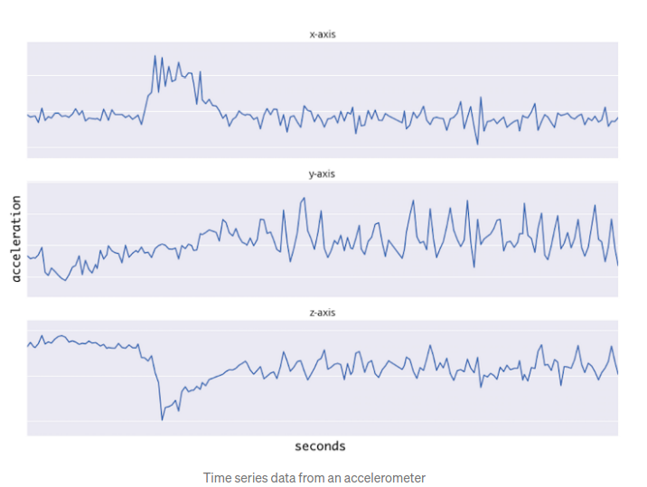
Conv1D, Conv2D
Example: Accelerometer (Sensor) Data - made of 2 dimensions.
The first dimension is time-steps and other is the values of the acceleration in 3 axes.

Slide 79
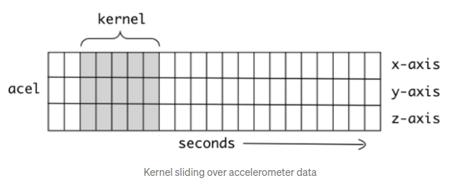
Conv1D, Conv2D
Example: Accelerometer Data - made of 2 dimensions
The first dimension is time-steps and other is the values of the acceleration in 3 axes

Slide 80


Conv1D, Conv2D
Another example of the “sliding over 1d data” -
In code, Conv1D looks like this:
input_shape (120, 3) represents 120 time-steps with 3 data points in each time step. These 3 data points are acceleration for x, y and z axes
kernel_size is 5, representing the width of the kernel, and kernel height will be the same as the number of data points in each time step

Slide 81
Conv1D, Conv2D
To sum up:
In 1D CNN, kernel moves in 1 direction; Input and output data of 1D CNN is 2D (dimensions). Mostly used on Time-Series data
In 2D CNN, kernel moves in 2 directions. Input and output data of 2D CNN is 3D (dimensions). Mostly used on Image data.
Conv Layer Type | Direction | Input and Output | Mostly used in
1D CNN | 1 direction (e.g. top bottom) | 2 dimensions (H, W) | Time-Series Data
2D CNN | 2 directions (h + w) | 3 dimensions (H, W, D) | Image Data

Slide 82

Conv1D, Conv2D
Reshape Data sets
Keras Conv1D layer expects input shape in 3D as:
However, in our exercise, our current data was in the shape of: (batch_size, features)
So, in order to overcome this, we should reshape our data -
sample_size = train_data.shape[0] # number of samples in train set // 404
attributes = train_data.shape[1] # number of features in train set // 13 columns / data attributes
input_dimension = 1 # each feature is represented by 1 number // 1
train_data_reshaped = train_data.reshape(sample_size, attributes, input_dimension) // (404, 13, 1)

Slide 83

Regularization (ML)
Why do we need regularization?
Our goal is to “punish” our model, so eventually he won’t do “too good” on the data.
This “too good” phenomena is also known as overfitting.
In a word - overfitting is knowing pretty well the training data, but know nothing when it comes to new, unseen data.
this technique discourages learning a more complex or flexible model.
Where λ is regularization power
source
Notes:
55*55*96

Slide 84

Regularization
source
Notes:
55*55*96

Slide 85

Regularization
while going towards the right, the complexity of the model increases such that the training error reduces but the testing error doesn’t.
A more complex model (more neurons, layers, depth, …) usually will get you to a lower error on the training set, however that’s not 100% the case on the test set
source
Notes:
55*55*96

Slide 86
Regularization - main types in DL
There are several types of regularization in DL. Let’s go over the main ones -
L1 Regularization
L2 Regularization
Dropout
Data Augmentation
Early Stopping
Most common
source
Notes:
55*55*96

Slide 87

Regularization - L1 Regularization
L1 Regularization - also known as “Lasso Regression”
Lasso Regression (Least Absolute Shrinkage and Selection Operator) adds “absolute value of magnitude” of coefficient as penalty term to the loss function.
In mathematical notations, this means that:
source
Notes:
55*55*96

Slide 88

Regularization - L2 Regularization
L2 Regularization - also known as “Ridge Regression”
Ridge regression adds “squared magnitude” of coefficient as penalty term to the loss function. Here the highlighted part represents L2 regularization element.
In mathematical notations, this means that:
from keras import regularizers
model.add(Dense(64, input_dim=64,
kernel_regularizer=regularizers.l2(0.01)
source
Notes:
55*55*96

Slide 89


Regularization - Dropout
Dropout Technique - one of the most interesting techniques in DL
Dropout produces very good results and is widely used in Deep Learning models.
source
Notes:
55*55*96

Slide 90
Regularization - Dropout
Dropout Technique - one of the most interesting techniques in DL
Dropout produces very good results and is widely used in Deep Learning models.
So what does dropout do?
At every iteration, it randomly selects few nodes, with probability P, and removes them along with all of their incoming and outgoing connections as shown above.
So each iteration has a different set of nodes and this results in a different set of outputs.
source
Notes:
55*55*96

Slide 91

Regularization - Dropout
Source: chatbotslife
Notes:
55*55*96

Slide 92
Regularization - Dropout
Dropout represents to us the idea of “Ensemble models”.
Ensemble modeling is a process where multiple diverse models are created to predict an outcome, either by using many different modeling algorithms or using different training data sets
Ensemble models usually perform better than a single model as they capture more randomness.
Similarly, dropout also performs better than a normal neural network model.
This probability of dropout is a hyperparameter which we’ll need to tweak.
from keras.layers.core import Dropout
model = Sequential([
Dense(input_shape=128, activation='relu'),
Dropout(0.25), -- note: the rate is always between 0-1
Dense(output_dim=64, activation='softmax')])
Source: chatbotslife
Notes:
55*55*96

Slide 93

Regularization - Data Augmentation
Another cool way to reduce overfitting is to use Data Augmentation.
Basically, it is the process of creating from nothing (in hebrew it sounds better…), and eventually is increasing the size of our dataset.
For example, if we are dealing with images data, we can pretty easily (and super easy with our APIs) to increase our dataset size by applying some transformations onto images.
For example:
Source
Notes:
55*55*96

Slide 94
Regularization - Data Augmentation
Why it works?
More data gives more “insights” to the model. E.g.: the digit “2” can be also “upside-down”, shifted to left, etc.
More diversified dataset, not only the same “1”
increasing generalization ability of the models, now they can be much better
helping resolve class imbalance issues in classification (mostly for imbalanced classification problems)
from keras.preprocessing.image import ImageDataGenerator
datagen = ImageDataGenerator(horizontal_flip=True)
datagen.flow(train)
Also, Albumentations
Source
Notes:
55*55*96

Slide 95
Regularization - Data Augmentation (a bit more…)
For image classification:
Data augmentation techniques are popular on visual data, where the goal is to make simple alternations on a given image(s).
In addition, generative adversarial networks (GANs) are used to create new synthetic data. Classic image processing activities for data augmentation are:
padding | random rotating | re-scaling
vertical and horizontal flipping | adding noise | Random erasing
translation (image is moved along X, Y direction) | cropping | zooming
darkening & brightening/color | modification | Grayscaling + Contrast
Notes:
55*55*96

Slide 96

Regularization - Data Augmentation (a bit more…)
Notes:
55*55*96

Slide 97


Regularization - Data Augmentation
Code examples (in Keras) - source
Horizontal Shift Augmentation
Notes:
55*55*96

Slide 98


Regularization - Data Augmentation
Code examples (in Keras)
Vertical Shift Augmentation
Notes:
55*55*96

Slide 99


Regularization - Data Augmentation
Code examples (in Keras)
Random Rotation Augmentation
Notes:
55*55*96

Slide 100

Regularization - Early Stopping
Early stopping is a technique where we want to make sure we don’t start to overfit.
Specifically, when the performance on a validation/test set gets worse from an iteration to an iteration, we will immediately stop the training process.
stop!
Source
Notes:
55*55*96

Slide 101
Regularization - Early Stopping
Early stopping is a technique where we want to make sure we don’t start to overfit.
Specifically, when the performance on a validation/test set gets worse from an iteration to an iteration, we will immediately stop the training process.
from keras.callbacks import EarlyStopping
EarlyStopping(monitor='val_err', patience=5)
monitor denotes the metric we should monitor in order to know if we are getting worse / not
Patience is the number of epochs we will be “patient” about, until we’ll stop training, given there was no improvement
Source
Notes:
55*55*96

Slide 102
Regularization - Ex. time
Let’s practice Regularization in Keras!
In the following exercise, you will have a chance to implement several regularizations in Keras, and check models with and without them, in order to see who performs better (with? without?)
Folder Name: Deep Learning
The Ex. name is “Regularization.ipynb”
Notes:
55*55*96

Slide 103
Regularization Dropout - Ex. time
Let’s practice Dropout!
As mentioned, one of the greatest techniques that helps in reducing overfitting in DL is Dropout.
In the following exercise, you will have a chance to try out different dropout rates (p), and will be able to check which had the greatest effect on the model, in terms of performance.
Folder Name: Deep Learning
The Ex. name is “Dropout.ipynb”
Good luck!
Notes:
55*55*96

Slide 104
Q&A Time

Slide 105

Activation Functions
Source

Slide 106
Activation Functions
Why do we need Activation Functions?
Using an activation function on a linear transformation, e.g. activation(wx+b), adds another step at each relevant layer during the forward + backward propagation.
The question is - do we need it if it just adds complexity?
Think about a neural network without activation function. In this case, every neuron will generate a linear transformation on the inputs using the weights & biases.
Meaning - a Deep Neural Network without activation function is just a linear model, for example:
Z1 = W1x1 + b1
Z2 = W2(Z1) + b2
Z3 = W3(Z2) + b2

Slide 107


Activation Functions
Most of the times - our data is not linearly splitted (and for linear split we don’t need NNs).
Linear transformations make the neural network simpler, but this network would be less powerful and will not be able to learn the complex patterns from the data.
The purpose of an activation function is to add some kind of non-linear property to the function, which is a neural network. Without the activation functions, the neural network could perform only linear mappings from inputs x to the outputs y.
Since a single dot product, as we saw, is a linear operation, successive (one after another) dot products would be nothing more than multiple linear operations repeated one after the other. And successive linear operations can be considered as a single linear operation.
In order to be able to compute really interesting stuff, neural networks must be able to approximate nonlinear relations from input features to output labels

Slide 108


Activation Functions
Let’s talk about the main activation functions
Sigmoid
Squashes input between 0 and 1
Historically popular since they have nice interpretation as a saturating “firing rate” of a neuron
Numeric examples:
sigmoid(6) = 1/(1 + e^-6) = 0.997
sigmoid(100) = 1/(1+e^-100) = 1
sigmoid(-100) = 1/(1+e^100) ~~ 0
Problems:
As you see, outputs for very small “x”s can be 0
Output is not zero-centered
Exponent is an expensive operation

Slide 109

Activation Functions
Let’s talk about the main activation functions
Tanh (Tangent Hyperbolic)
Squashes input between -1 and 1
Zero centered
Still kills gradients :(
Numeric example:
tanh(0) = (e^0 - e^-0) / (e^0 + e^-0) = 0
tanh(100) = (e^100 - e^-100) / (e^100 + e^-100) = 1
tanh(-100) = (e^-100 - e^100) / (e^-100 + e^100) = -1

Slide 110


Activation Functions
Let’s talk about the main activation functions
ReLU (Rectified Linear Unit)
Does not saturate (in the positive region)
Very computationally efficient
Not zero-centered output
Converges much faster than sigmoid/tanh in practice (e.g. 6x)
Numeric example:
f(6) = 6
f(-4) = 0
f(0) = 0

Slide 111


Activation Functions
Let’s talk about the main activation functions
Leaky ReLU (Leaky Rectified Linear Unit)
Does not saturate (in the positive region)
Very computationally efficient
Will not die!
Converges much faster than sigmoid/tanh in practice (e.g. 6x)
Numeric example:
f(6) = 6
f(-4) = -0.04
f(0) = 0
(There is another version of Leaky ReLU, such as: Parametric Rectifier (PReLU)), which gets this 0.01 and turns it into a parameter (alpha).
Then, this parameter can be learned via Back Propagation

Slide 112
Activation Functions
Summary - let’s see some code!
Activation Functions Keras Tutorial

Slide 113
Framework (Keras) Overview + Tutorial
Let’s revisit, if needed, Keras once again
Keras Framework Tutorial

Slide 114
Overfitting / Underfitting in DL
This relatively short lecture will focus on two main phenomena in DL - Overfitting and Underfitting, specifically in DL.
For that, let us define the two -
Overfitting:
When an algorithm fits the training data “too good”, but when a new data point arrives it knows nothing about it, and predicts poorly.
Underfitting:
When an algorithm is not fitting the training data well, it is called “underfitting” in terms of its performance.
Usually, this comes when a model is too simple to the data (e.g. a line for splitting 2 classes when the data is not linearly splittable)
In order to know if we are overfitting / underfitting, we MUST monitor our loss functions AND our model’s performance

Slide 115

Overfitting / Underfitting in DL
source
Notes:
55*55*96

Slide 116
Overfitting / Underfitting in DL
We can take several steps when one of these phenomenon occur, and below you will be able to find few of them -
Underfitting:
For example, we can add new features to our X, and more feature “products” (e.g. x1*x2)
We can also change the types of feature processing used (e.g., increasing n-grams size in text related tasks)
In case we are using regularization (which we discussed), we can maybe decrease the amount of regularization used, so we won’t “punish” our model too much, such that it won’t be able to learn
Remove noise / outliers from the data (maybe they just “bother” the training process)
Increase the number of epochs, so the model will “see” the same data at least few more times
Clarification - You can think of a for-loop over the number of epochs where each loop proceeds over the training dataset. Within this for-loop is another nested for-loop that iterates over each batch of samples, where one batch has the specified “batch size” number of samples
source
Notes:
55*55*96

Slide 117
Overfitting / Underfitting in DL
We can take several steps when one of these phenomenon occur, and below you will be able to find few of them -
Overfitting:
Increase training data - we can for example generate or get more data (e.g. more days, more users, more images, …)
Feature Selection - choose the relevant features and not just “all of the data you have”. Not all of the features are relevant
Reduce model complexity - maybe we don’t need 1000 layers of 1000 neurons each?
Early stopping during the training phase - to make sure we don’t harm our eval loss + accuracy
Use L1 (Lasso) and L2 (Ridge) Regularization techniques
Use dropout for neural networks in order to diversify the models and to make sure they generalize
source
Notes:
55*55*96

Slide 118
A word about GPUs
Before proceeding with our content, I wanted to provide some explanation behind GPUs and training with GPUs -
You will heavily discuss this in the next course, so we won’t dive into it now
We can train Keras models with GPU, you just need to check that:
Your system has GPU (Nvidia mostly, AMD not working yet with Keras)
You have installed the GPU version of tensorflow
Verify that tensorflow is running with GPU check if GPU is working (tensorflow) import tensorflow as tf print("Num GPUs Available: ", len(tf.config.list_physical_devices('GPU'))) // inside some notebook

Slide 119

A word about GPUs
Why GPUs are so fast?
GPUs are designed with one main goal in mind: process graphics really fast! Since this is the only concern they have, there have been some specialized optimizations in place that allow for certain calculations to go a LOT faster than they would in a traditional processor (CPU)

Slide 120
Weight Initialization in DL
One of the core components in having good models in DL are weight initializations.
This process is a core component because it directly affects our training process.
This is because of the fact that eventually, and after all layers, neurons, convolutional, pooling, and any mathematical operations, we are willing to update our weights such that it will get us to the “best” mapping of X->Y (in supervised), and will minimize our loss.
There are many ways to initialize our weights (W, b), within this lecture we’ll discuss the main ones.
source
Notes:
55*55*96

Slide 121
Weight Initialization in DL
Why do we want this?
Except of getting our loss to minimum, we would like to prevent layer activation outputs from exploding or vanishing during the course of a forward pass through a deep neural network. If either occurs, loss gradients will either be too large or too small to flow backwards beneficially, and the network will take longer to converge, if it is even able to do so at all.
Meaning, in simple words - our gradients (which control our weight updates) will be too small or too large to be updated. In both ways, we might “undershoot” or “overshoot” our goal (which is convergence).
source
Notes:
55*55*96

Slide 122
Weight Initialization in DL
Random Initialization
The first initialization we’ll see is random.
This means that we will initialize our weights without too much “domain knowledge” on what’s going within the network.
In Keras, Random Initialization is pretty simple and requires few lines of code, which we’ll see in a bit.
source
Notes:
55*55*96

Slide 123

Weight Initialization in DL
Xavier Initialization
This initialization is named after Xavier Glorot, following his research with Yoshua Bengio (one of the greatest DL researches out there).
This initialization basically takes into consideration two parameters - the number of connections in the current layer, and the number of connections in the next layer.
Xavier initialization sets a layer’s weights to values chosen from a random uniform distribution that’s bounded between
source
Notes:
55*55*96

Slide 124

Weight Initialization in DL
Xavier Initialization
Xavier Glorot and Bengio believed that Xavier weight initialization would maintain the variance of activations and back-propagated gradients all the way up or down the layers of a network.
In their experiments they observed that Xavier initialization enabled a 5-layer network to maintain near identical variances of its weight gradients across layers.
source
Notes:
55*55*96

Slide 125
Weight Initialization in DL
Kaiming (He) Initialization
One of the challenges that Xavier initialization had is the fact that there are some “non-normal” layers, such as non-linearity (e.g. Activation function such as ReLU).
This was the basic idea and motivation for Kaiming He et. al to propose their own method for weights initialization.
Their method is tailored for Deep NNs that does use these kinds of asymmetric, non-linear activations.
source
Notes:
55*55*96

Slide 126
Weight Initialization in DL
Kaiming (He) Initialization
In their 2015 paper, He et. al. demonstrated that Deep NNs (e.g. a 22-layer CNN) would converge much earlier if the following input weight initialization strategy will be as follows:
Create a tensor with the dimensions appropriate for a weight matrix at a given layer, and populate it with numbers randomly chosen from a standard normal distribution
Multiply each randomly chosen number by √2/√n where n is the number of incoming connections coming into a given layer from the previous layer’s output (also known as the “fan-in”)
Bias tensors are initialized to zero
source
Notes:
55*55*96

Slide 127

Weight Initialization in DL
Kaiming (He) Initialization
Interesantly, when they trained even deeper networks that used ReLUs, He et. al. found that a 30-layer CNN using Xavier initialization didn’t learn at all.
However, when the same network was initialized according to the three-step procedure we just mentioned, it enjoyed substantially greater convergence.
source
Notes:
55*55*96

Slide 128
Weight Initialization in DL
Keras Tutorial on Layer weights initialization
Basically, this two methods are widely used, though most of the DL networks does have some ReLU activations somewhere, so He. (Kaiming) would be the way to go.
Now, let’s see how this is done using Keras
Notes:
55*55*96

Slide 129
Weight Initialization in DL
Another great post on Weight Initialization, let’s go over it
Notes:
55*55*96

Slide 130
Optimization Methods - Overview
Up till now, you have met with with one main Optimization Algorithm - Gradient Descent.
As a reminder, we are trying to minimize our loss function with respect to the models relevant parameters (usually W, B), in order to make sure we are able to minimize our errors, and thus getting better with our predictions.
Alongside that, there are several methods, and this lecture will now walk you through into the main ones which are used, with some concrete code examples.
Notes:
55*55*96

Slide 131
Optimization Methods
Gradient Descent
Batch gradient descent (GD variant)
Stochastic gradient descent (GD variant)
Mini-batch gradient descent (GD variant)
Challenges with the classic Gradient Descent (and its variants)
Momentum
Nesterov accelerated gradient
Adagrad
Adadelta
RMSprop
Adam
source
Notes:
55*55*96

Slide 132
Optimization Methods - Gradient Descent
Gradient descent - reminder
Gradient descent is a way to minimize an objective function J(θ) parameterized by a model's parameters θ∈Rd,
by updating the parameters in the opposite direction of the gradient of the objective function ∇θJ(θ) w.r.t. to the parameters.
The learning rate η (“eta”) determines the size of the steps we take to reach a (local) minimum.
In simple words, we follow the direction of the slope of the surface created by the objective function downhill until we reach a valley.
Notes:
55*55*96

Slide 133
Optimization Methods - Gradient Descent
Gradient descent variants
There are three variants of gradient descent, which differ in how much data we use to compute the gradient of the objective function. Depending on the amount of data, we make a trade-off between the accuracy of the parameter update and the time it takes to perform an update.
Batch gradient descent
Stochastic gradient descent
Mini-batch gradient descent
Notes:
55*55*96

Slide 134
Optimization Methods - BGD
Batch Gradient Descent
The Vanilla version of gradient descent, aka batch gradient descent, computes the gradient of the cost function w.r.t. to the parameters θ for the entire training dataset:
θ = θ − η⋅∇θJ(θ).
For example: W1_1 = W1_0 - eta * (gradient at specific function)
As we need to calculate the gradients for the whole dataset to perform just one update, batch gradient descent can be very slow and is intractable for datasets that don't fit in memory. Batch gradient descent also doesn't allow us to update our model online, i.e. with new examples on-the-fly.
Notes:
55*55*96

Slide 135
Optimization Methods - BGD
Batch Gradient Descent
In code, Batch Gradient Descent can look something like this:
for i in range(num_epochs): //running over all epochs
params_grad = evaluate_gradient(loss_function, data, params)
params = params - learning_rate * params_grad //every epoch we update our params (W, b) once
Notes:
55*55*96

Slide 136
Optimization Methods - SGD
Stochastic Gradient Descent
Stochastic gradient descent (SGD) in contrast performs a parameter update for each training example x(i) and label y(i):
θ=θ−η⋅∇θJ(θ;x(i);y(i)).
For example: W1_1 = W1_0 - eta * (gradient at specific function and at specific data point)
Meaning, every time we have a new data point (x, y), we make sure to update our parameters (w, b - theta in a generic form).

Slide 137

Optimization Methods - SGD
Stochastic Gradient Descent
Batch gradient descent performs redundant computations for large datasets, as it recomputes gradients for similar examples before each parameter update.
SGD does away with this redundancy by performing one update at a time. It is therefore usually much faster and can also be used to learn online.
SGD performs frequent updates with a high variance that cause the objective function to fluctuate heavily, due to the “every step - update” nature of it -

Slide 138
Optimization Methods - SGD
Stochastic Gradient Descent
While batch gradient descent converges to the minimum of the basin the parameters are placed in, SGD's fluctuation, on the one hand, enables it to jump to new and potentially better local minima.
On the other hand, this ultimately complicates convergence to the exact minimum, as SGD will keep overshooting.
Its code fragment simply adds a loop over the training examples and evaluates the gradient w.r.t. each example
In code, SGD can be seen as something like:
for i in range(nb_epochs):
for example in data: //now, update is done every example i of pair (x_i, y_i)
params_grad = evaluate_gradient(loss_function, example, params)
params = params - learning_rate * params_grad

Slide 139
Optimization Methods - MBGD
Mini-Batch Gradient Descent
Mini-batch gradient descent finally takes the best of both worlds and performs an update for every mini-batch of
n training examples:
θ=θ−η⋅∇θJ(θ;x(i:i+n);y(i:i+n)). For example: W1_1 = W1_0 - eta * (gradient at function and “few” data points)
This way, it:
Reduces the variance of the parameter updates, which can lead to more stable convergence
Can make use of highly optimized matrix optimizations common to state-of-the-art deep learning libraries that make computing the gradient w.r.t. a mini-batch very efficient.
Common mini-batch sizes range between 32 and 256, but can vary for different applications.
Mini-batch gradient descent is typically the algorithm of choice when training a neural network and the term SGD usually is employed also when mini-batches are used.

Slide 140
Optimization Methods - MBGD
Mini-Batch Gradient Descent
In code, MBGD can be seen as something like:
for i in range(nb_epochs):
for batch in get_batches(data, batch_size=32): // a function that splits data into mini-batches
params_grad = evaluate_gradient(loss_function, batch, params)
params = params - learning_rate * params_grad

Slide 141
Challenges with Vanilla Gradient Descent
Challenges
Vanilla mini-batch gradient descent, however, does not guarantee good convergence, but offers a few challenges that need to be addressed:
Choosing a proper learning rate can be difficult, this is a hyperparameter that needs to be tuned. A learning rate that is too small leads to painfully slow convergence, while a learning rate that is too large can hinder convergence and cause the loss function to fluctuate around the minimum or even to diverge
Learning rate “schedules” try to adjust the learning rate during training by reducing the learning rate according to a predefined schedule (every X epochs…) or when the change in objective between epochs falls below a threshold. These schedules and thresholds, however, have to be defined in advance and are thus unable to adapt to a dataset's characteristics
Additionally, the same learning rate applies to all parameter updates. If our data is sparse and our features have very different frequencies, we might not want to update all of them to the same extent, but perform a larger update for rarely occurring features
Notes:
55*55*96

Slide 142

GD Optimization Algorithms
Momentum
SGD has trouble navigating areas where the surface curves much more steeply in one dimension than in another, which are common around local optima.
In these scenarios, SGD oscillates across the slopes of the “ravine” while only making hesitant progress along the bottom towards the local optimum as in below -
source
Notes:
55*55*96

Slide 143
GD Optimization Algorithms
Momentum
In code, Momentum looks like something as:
vt = γvt−1 + η∇θJ(θ)
θ = θ −vt
Where momentum term (γ) usually set to 0.9 or a similar value.
Essentially, when using momentum, it’s like we push a ball down a hill.
You can also think of γ as the "velocity" of a ball rolling downhill, building up speed (and momentum) according to the direction of the gradient/slope of the hill.
The ball accumulates momentum as it rolls downhill, becoming faster and faster on the way (until it reaches its terminal velocity if there is air resistance, i.e. γ<1).
The same thing happens to our parameter updates:
The momentum term increases for dimensions whose gradients point in the same directions and reduces updates for dimensions whose gradients change directions. As a result, we gain faster convergence and reduced oscillation.
source
Notes:
55*55*96

Slide 144
GD Optimization Algorithms
Nesterov accelerated gradient (NAG)
The downside of “Momentum”, However, is that a ball that rolls down a hill, blindly following the slope, is highly unsatisfactory.
We'd like to have a smarter ball, a ball that has a notion of where it is going so that it knows to slow down before the hill slopes up again.
Nesterov accelerated gradient (NAG) is a way to give our momentum term this kind of prescience.
We know that we will use our momentum term γvt−1 to move the parameters θ.
Computing θ − γvt−1 thus gives us an approximation of the next position of the parameters (the gradient is missing for the full update), a rough idea where our parameters are going to be.
source
Notes:
55*55*96

Slide 145
GD Optimization Algorithms
Nesterov accelerated gradient (NAG)
We can now effectively look ahead by calculating the gradient not w.r.t. to our current parameters θ but w.r.t. the approximate future position of our parameters.
In code, NAG looks something like this:
vt = γvt−1 + η∇θJ(θ−γvt−1)
θ = θ−vt
source
Notes:
55*55*96

Slide 146

GD Optimization Algorithms
RMSprop
RMSprop was proposed by the father of back-propagation, Geoffrey Hinton. Gradients of very complex functions like neural networks have a tendency to either vanish or explode as the data propagates through the function (*refer to vanishing gradients problem).
RMSprop deals with the above issue by using a moving average of squared gradients to normalize the gradient. This normalization balances the step size (momentum), decreasing the step for large gradients to avoid exploding, and increasing the step for small gradients to avoid vanishing.
source
Notes:
55*55*96

Slide 147

GD Optimization Algorithms
Adam (ADAptive Moment estimation)
Adaptive Moment Estimation (Adam) is another method that computes adaptive learning rates for each parameter. In addition to storing an exponentially decaying average of past squared gradients vt like RMSprop, Adam also keeps an exponentially decaying average of past gradients mt, similar to momentum. Whereas momentum can be seen as a ball running down a slope, Adam behaves like a heavy ball with friction, which thus prefers flat minima in the error surface. We compute the decaying averages of past and past squared gradients mt and vt respectively as follows:
source
Notes:
55*55*96

Slide 148



GD Optimization Algorithms
Adam (ADAptive Moment estimation)
mt and vt are estimates of the first moment (the mean) and the second moment (the uncentered variance) of the gradients, respectively, hence the name of the method. As mt and vt are initialized as vectors of 0's, the authors of Adam observe that they are biased towards zero, especially during the initial time steps, and especially when the decay rates are small (i.e. β1 and β2 are close to 1). They counteract these biases by computing bias-corrected first and second moment estimates:
They then use these to update the parameters just as we have seen in Adadelta and RMSprop, which yields the Adam update rule:
source
Notes:
55*55*96

Slide 149
GD Optimization Algorithms
Adam
The authors propose default values of 0.9 for β1, 0.999 for β2, and 10^−8 for ϵ. They show empirically that Adam works well in practice and compares favorably to other adaptive learning-method algorithms.
As of today, Adam is one of the most used optimization algorithms out there. So, the rule is - when in doubt, use Adam.
Also, most libraries (Keras, PyTorch) use the relevant optimizers we just discussed so it’s pretty easily to use these, just by “picking” the relevant one for your trial and error.
A deeper intro to Adam including math calculations, for those interested, can be found here
source
Notes:
55*55*96

Slide 150
Project Instructions
Let’s talk about the project - I want you to have something you can be proud of
Dataset: Fashion MNIST
Build & train a Deep Learning network (CNN / NN) using Keras API that will be able predict the dataset’s X instance class
(you already know how to do it)
Train at least 2 times the model, and log some parameters using W&B (will be learned)
Save the trained model in ONNX format (will be learned) - optional
Wrap the model in Flask API (will be learned)
Predict API - will generate a prediction probability of the relevant class (e.g. 0.97 that this image is a Dress)
Make sure that the Dataset is within the machine so you will be able to send a request with the path of some image (as a note, not a requirement)
Once wrapped, wrap both the API + the model into a docker container (will be learned)
Project is considered done once you are able to query the model and get a prediction(“Y”) with a some “X” (image), and you are able to do so within the wrapping docker container
in our case, X is defined as an image
In our case, Y is defined as a label

Slide 151
Project Instructions
To sum up, the tech stack you are going to use are:
Deep Learning model using Keras API
Flask API for model hosting
Weights & Biases for experiment tracking
Docker for containerizing the above
(optional - up to you - can be relevant Python libraries for dataset preprocessing + ONNX)
A great tutorial which covers most of the stuff (ML, Flask, Docker) can be found here

Slide 152

Project Instructions
With regards to development environment, the project can be done from the terminal of the machines we’re working on, or (also recommended) - locally on your end!

Slide 153


Project Instructions
Tips slide: You should make sure you have:
Docker installed (just type “docker” in the terminal and see no error)
Flask installed (you can check the below commands in the terminal if you want)
DockerFile
DL Model code (train + test) - i.e. Python scripts (“.py” files or notebooks “.ipynb”)
Flask code - i.e. another Python script (“.py” file)

Slide 154

Weights and Biases

Slide 155
W&B - Intro
Weights & Biases is the machine learning platform for developers to build better models faster.
Use W&B's lightweight, interoperable tools to quickly track experiments, version and iterate on datasets, evaluate model performance, reproduce models, visualize results and spot regressions, and share findings with colleagues.
Set up W&B in 5 minutes, then quickly iterate on your machine learning pipeline with the confidence that your datasets and models are tracked and versioned in a reliable system of record.

Slide 156
What W&B contains
Experiment Tracking
Using few lines of code, it is super easy to spin up a new experiment, track its relevant configurations, see how they increase / decrease accuracy, reiterate...
Integrations
W&B supports integrations with many platforms e.g. PyTorch, Keras, AWS SageMaker, Databricks, …
In simple words, it means that we can use this tool in any modern platform today
Hyperparameter Tuning
W&B offers “sweeps” which is a component that automates hyperparameter
optimization and explore the space of possible models

Slide 157
What W&B contains
Data + Model Versioning
This is a very cool feature, in which one can version not only code but also data and model. It is known as “artifacts”
Collaborative Reports
One can generate reports that contains relevant graphs and text about experiment, share it with stakeholders. Super relevant for explainability, data analysis purposes
Self Hosting
The last component is called “self hosting”, and basically it is spinning up a server (locally / remote) that will host W&B, thus one can keep its data safe

Slide 158
Let’s dive into each of the components
Experiment Tracking
What’s an experiment? Essentially, it’s training a model over some data and getting results.
However, the difference relies in the fact that we are trying several configurations, e.g.:
Different learning rate (eta)
Different optimizer (adam? sgd?)
Different number of epochs (10? 20? 30?)
Different data split
...

Slide 159


Let’s dive into each of the components

Slide 160
Let’s dive into each of the components
Integrations
As mentioned, integrations focuses on bringing this product into the main and modern ML frameworks (e.g. PyTorch), repositories (e.g. HuggingFace), services (e.g. AWS SageMaker).
It basically contains tons of information about how to customize the W&B integration into each of these, as each one of them has its own set of configurations, connection, etc.

Slide 161



Let’s dive into each of the components
Integrations
ML / DL frameworks
ML / DL repositories
ML / DL / other tools

Slide 162
Let’s dive into each of the components
Hyperparameter Tuning (Optimization)
In ML & DL, hyperparameter optimization or tuning is the problem of choosing a set of optimal hyperparameters for a learning algorithm.
A hyperparameter is a parameter whose value is used to control the learning process, for example:
Learning rate: 0.01/ 0.02 / 0.1 / 0.001 / …
Early stopping (by number of epochs): 7 / 10 / 20 / ...

Slide 163
Let’s dive into each of the components
Hyperparameter Tuning (Optimization)
There are several strategies to hyperparameter tuning, such as:
Random Search Optimization
Grid Search Optimization
Bayesian Optimization
Let’s walk each one of them accordingly...

Slide 164

Let’s dive into each of the components
Hyperparameter Tuning (Optimization) - Random Search
Given a search space with some parameters,
Let us pick some random combination of them and
run the model accordingly, store results, and
then try other set of parameters.
source

Slide 165

Let’s dive into each of the components
Hyperparameter Tuning (Optimization) - Grid Search
Given a search space with some parameters,
Let us pick any combination (e.g. x1, y1, x2, y2, …)
of them and run the model accordingly, store results, and
then try other set of parameters.
source

Slide 166
Let’s dive into each of the components
Hyperparameter Tuning (Optimization) - Bayesian Search
Bayesian Optimization is an approach that uses Bayes Theorem to direct the search in order to find the minimum or maximum of an objective function.
It is an approach that is most useful for objective functions that are complex, noisy, and/or expensive to evaluate
Out of the 3 methods presented, bayesian is most popular because it uses data to evaluate historical performance, and acts accordingly in the future (next iteration)

Slide 167

Let’s dive into each of the components
Hyperparameter Tuning (Optimization) - Bayesian Search
source

Slide 168

Let’s dive into each of the components
Hyperparameter Tuning (Optimization)
All of this theory is implemented as a “sweep” in W&B.
A “sweep” is an hyperparameter experiment. It contains several configurations in which one can have a full run of experiment, and then act accordingly!
source

Slide 169

Let’s dive into each of the components
Hyperparameter Tuning (Optimization)
It works by communicating with a W&B server, which based on our data (search space, model, parameters, …), it knows which iteration should one try next (also based on the method), and sends it back to the agent (our servers)
source

Slide 170
Let’s dive into each of the components
Data & Model Versioning (in W&B Artifacts)
A crucial ability for reproducibility is having anything related to our coding versioned!
In ML projects, that is:
Code + Project structure (for that we have GitHub)
ML Model
Data
You can think of an artifact as a versioned folder of data.
You can store entire datasets directly in artifacts, or use artifact references to point to data in other systems like AWS S3, GCP, or your own system.

Slide 171

Let’s dive into each of the components
Data & Model Versioning
source

Slide 172
Let’s dive into each of the components
Collaborative Reports
Collaborative Reports let one organize and embed visualizations, describe findings, share updates with collaborators, and more.
Main use-cases are:
Notes: Add a graph with a quick note to yourself
Collaboration: Share findings with your colleagues
Work log: Track what you've tried and plan next steps

Slide 173

Let’s dive into each of the components
source

Slide 174
ONNX

Slide 175
What is ONNX ?
”ONNX is an open format built to represent machine learning models. ONNX defines a common set of operators — the building blocks of machine learning and deep learning models — and a common file format to enable AI developers to use models with a variety of frameworks, tools, runtimes, and compilers” (see onnx.ai).

Slide 176

Why ONNX ?
There are many frameworks, each one of them has its own speciality

Slide 177

Why ONNX ?
The problem: No Interoperability - it’s not easy to move from Keras to PyTorch models, nor from developing on a machine to edge devices deployment!
source

Slide 178
Why ONNX ?
Notice the intense process:
Diverse toolkits, frameworks
training environments (local? cloud? dc?)
optimizing stack
production stack
data drift and lower accuracy? Redo #1 - #5

Slide 179

Why ONNX ?
“The ML forest”

Slide 180

Why ONNX ?
“The ML forest”

Slide 181
Here Comes ONNX
ONNX - Open Neural Network Exchange
The main goal of ONNX is to allow diversity in the ML space.
The specificity of ONNX even allows one to automatically compile the stored operations to lower level languages for embedding on various devices.
Effectively, an ONNX file will contain all you need to know to re-instantiate a full data processing pipeline when moving from one platform to the other (e.g. from PyTorch to Keras vice versa).
Allows to reduce a lot of moving parts when deploying and dealing with ML/DL models.

Slide 182
ONNX advantages
The main goal of ONNX is to allow diversity in the ML space.
The specificity of ONNX even allows one to automatically compile the stored operations to lower level languages for embedding on various devices.
Effectively, an ONNX file will contain all you need to know to re-instantiate a full data processing pipeline when moving from one platform to the other (e.g. from PyTorch to Keras vice versa).

Slide 183
ONNX Design Principles
Support traditional ML + DL
Flexible enough to keep up with rapid changes
Compact and cross-platform (supports PyTorch, Scikit-Learn, Keras, …)
Standardized list of well-defined operators informed by real world usage
Code written in one format -> code being “translated” to ONNX format -> ONNX can read and process the code accordingly

Slide 184

ONNX File Format
A model is a container for a graph that represents it (like a computation graph in NN)
Each model has a version info, metadata, and some acyclic data flow graph
Each graph is composed of inputs and outputs
Each graph has its own data types

Slide 185
ONNX Data Types
Tensor Type
int8, int16, int32, int64
uint8, uint16, uint32, uint64
float16, float, double
Bool
String
...

Slide 186

ONNX Operators
Maps a component in a model to ONNX operator
Each component (e.g. Relu activation layer) is converted into an operator
(Huge) List of supported operators can be found here

Slide 187

ONNX Use-Cases
Say you train a model to predict, for example,
house prices (aka Regression Problem)
You have several preprocessing steps to do:
Scaling inputs
Changing from categorical to numerical representation (e.g. ohe…)
Log transform our Y label (to make it same scale)
Then, you can infer using a trained model
Then, you will need to transform the price back to the original scale

Slide 188
ONNX Use-Cases
So, instead doing all of this in SKLearn, you can do it on ONNX, and then this pipeline can be relevant to any framework, ML tech, language!
This can be done relatively easy by creating “nodes” within that graph, where each graph is responsible to a different step

Slide 189

ONNX Use-Cases

Slide 190

ONNX Use-Cases
Inference ML models - from platform to platform
Consider the following block of code:
imports
model
onnx

Slide 191

ONNX Use-Cases
Inference ML models - from platform to platform
imports
Onnx rt
assertion

Slide 192
ONNX Full Example
Let’s go over a great post which demonstrated a full use case with ONNX

Slide 193

Docker

Slide 194
What is Docker?
“Docker helps developers bring their ideas to life by conquering the complexity of app development. We simplify and accelerate development workflows with an integrated dev pipeline and through the consolidation of application components”
In short, Docker is a software container platform.
You can create containerized applications, automate the deployment and have fun!
Packing, shipping, and running — made simpler, easier & definitely, faster!
With Docker, applications can comfortably run no matter where they are.
Using Docker enables you to package your entire application with all of its dependencies with zero headache for compatibility issues or machine dependency.

Slide 195
What is Docker?
Docker has a lot of components which anyone can easily use in order to automatically update its programs.
Now we’ll go through the basic jargon of Docker, in order to make sure we’re aligned -
VMs
Docker Containers
Docker Files + Docker Hub
Docker commands
Docker Images
Then, we’ll dive into a real ML example (which you can browse for your projects…)!

Slide 196
VMs
Simplest term - VM is nothing but an emulation of a real computer that can execute programs of sorts.
A virtual machine (VM) is a program on a computer that works like it is a separate computer inside the main computer.
Alongside that, another component is called “Hypervisor”, which is basically what Virtual Machines run on top of.
The program that controls VMs is called a hypervisor and the computer that is running the virtual machine is called the host.

Slide 197
VMs
VM - a program on a computer that works like a separate computer, inside a real computer
Hypervisor - VMs run on top of that component, and it controls them
Host - the computer that runs VMs (aka the “real computer”)

Slide 198
Docker Containers
The concept of Docker containers, similar to that of VM, also aims to achieve isolation in terms of applications and programs.
Containers, as the term suggests, “contains” every little thing that an application will need in order to be executed.
Think of it as a transportable box, filled with tools and libraries, configurations, settings, and all that is required for it to be executed.

Slide 199

Then what’s the diff between Docker Containers and VMs?
“Virtual machines and containers differ in several ways, but the primary difference is that containers provide a way to virtualize an OS so that multiple workloads can run on a single OS instance. With VMs, the hardware is being virtualized to run multiple OS instances” (source)
Containers don’t require a full OS instance, allowing multiple containers to run smoothly on a single host machine.
source

Slide 200

How to create a Docker Container?
Now that we know what a docker container is, let’s talk about the process for docker container creation.
In one line, dockerfile builds a docker image, from which you can run docker container.
A Dockerfile is a simple text file, with lines of instructions on how to build a docker image. So it’s basically a blueprint for images, that’s all.
Docker Images are blueprints for containers, similar to Class in Object Oriented Programming.
source

Slide 201
Docker Files
Docker can build images automatically by reading the instructions from a Dockerfile.
A Dockerfile is simply a text document that contains all the commands a user could call on the command line to generate an image.
Using docker build users can create an automated build that executes several command-line instructions in succession, one after the other.

Slide 202
Docker Files
Format: txt file
Content:
# Comment
INSTRUCTION arguments
Where instruction is a reserved word (usually 1-word) that tells what to do (e.g. RUN / ECHO / …), and arguments will tell how to do the specified action.
Examples:
FROM ubuntu
CMD echo "Hello Dockerfile"
FROM ubuntu
CMD ["/usr/bin/wc","--help"]
FROM will take an existing image (like import code…)
CMD will run a console in the command line, in this case echo

Slide 203
Docker Files
There are many commands in a dockerfile!
It helps to think about each of them as a function that gets inputs and performs them
Let’s go over the main ones:
RUN - will run whatever instructions are given
RUN echo hello world -> will print to screen hello world
RUN dir c:/ ->will run list files on c drive
RUN ["/bin/bash", "-c", "echo hello"] -> get a set of arguments and will execute them one by one, by order, from left to right
FROM - The FROM instruction initializes a new build stage and sets the Base Image for subsequent instructions.
As such, a valid Dockerfile must start with a FROM instruction. The image can be any valid image – it is especially easy to start by pulling an image from the Public Repositories.
The public repositories is known as Docker Hub (we’ll get there soon)!
(All taken from here)

Slide 204
Docker Files
ARG - allows to define arguments that will be used somewhere within the dockerfile, like variables inside a specific function
ARG CODE_V=latest
FROM my_relevant_image:${CODE_V}
CMD - Will perform relevant actions in the command line, as you would have write these manually
CMD /code/run-app.py --eta 0.1 --num_layers 10
CMD ["/code/run-app.py", "--eta 0.1", "--num_layers 10"]
The LABEL instruction adds metadata to an image. A LABEL is a key-value pair (think of tags)
LABEL "com.example.vendor"="ACME Incorporated"
LABEL com.example.label-with-value="foo"
LABEL version="1.0"
LABEL description="This text illustrates \ that label-values can span multiple lines."

Slide 205
Docker Files
ENV - Defines environment variables. This value will be in the env for all subsequent instructions in the build stage
ENV MY_NAME="John Doe"
ENV MY_DOG=Rex\ The\ Dog
ENV MY_CAT=fluffy
ADD - adds relevant configurations / files to whatever you basically want
ADD --chown=55:mygroup files* /somedir/
ADD test.txt /absoluteDir/
COPY - as it is, copies whatever you basically want FROM TO
COPY hom* /mydir/
COPY hom?.txt /mydir/

Slide 206
Docker Files
Order matters in a docker file!
There are specific order rules that one should follow in order to make sure the dockerfile is indeed valid.
Place static instructions higher in the order. Instructions like, but not limited to, EXPOSE, VOLUME, CMD, ENTRYPOINT, and WORKDIR whose value is not going to change once it is set
Place dynamic instruction lower in the order. Instructions like ENV (when using variable substitution), ARG
Place dependency RUN instructions before ADD or COPY instructions
Place ADD and COPY instructions after RUN instructions for installing dependencies but before dynamic instructions

Slide 207
Docker Files - a full example
FROM ubuntu
RUN \
apt-get update && \
apt-get install -y wget sudo supervisor python-software-properies && \
apt-get update && \
add-apt-repository ppa:saltstack/salt && \
apt-get update
EXPOSE 4505 4506
CMD ["/sbin/sshd"]
Note how we combined few “RUN” commands

Slide 208
Docker Images
Docker Images are the output of the Dockerfiles.
This basically means that using the dockerfile, we can build a docker image, that will eventually can be run and thus generate us the docker container.
We can create Docker Images / we can use existing ones!
For using existing ones, there’s the “github” of Docker - “Docker Hub”.
Let’s have a quick review of Docker Hub

Slide 209
Docker Commands
docker run - a command that takes a docker image, and creates a docker container from it
docker start – starts one or more stopped containers
docker stop – stops one or more running containers
docker build – builds an image from a Dockerfile
docker pull – pulls an image or a repository from a registry
docker push – pushes an image or a repository to a registry
docker export – exports a container’s filesystem as a tar archive
docker search – searches the Docker Hub for images

Slide 210
Docker Flags
the -d flag causes Docker to start the container in "detached" mode. A simple way to think of this is to think of -d as running the container in "the background," just like any other Unix process
Given this example:
docker run -d \
-v "/${PWD}:/workspace" \
-p 8080:8080 \
--name "ml-workspace" \
--env AUTHENTICATE_VIA_JUPYTER="mytoken" \
--shm-size 2g \
--restart always \
dagshub/ml-workspace:latest
-v stands for “volume”. It allows you to retain your work (files) after the container shuts down, and to access them from outside the container.
It does this by mapping your current working folder (where you execute the docker run command), denoted as /${PWD}, to a /workspace folder inside the container's virtual file system. If you'd like to change that, you can change this argument appropriately
The -p argument exposes the 8080 port. In essence it means that after you run this on a computer, your container will be accessible via http://{computer-ip}:8080. If you're running this on your local system, that address will be http://localhost:8080
This generates a unique identifier for our container for future reference. As it might imply, this name should be unique per your system, so if you make multiple containers from the same image, you'll need to define different names for them. --name is also useful to add meaning to our container. If you don't define a name, a meaningless one will be generated for you automatically

Slide 211
Docker Flags
Given this example:
docker run -d \
-v "/${PWD}:/workspace" \
-p 8080:8080 \
--name "ml-workspace" \
--env AUTHENTICATE_VIA_JUPYTER="mytoken" \
--shm-size 2g \
--restart always \
dagshub/ml-workspace:latest
The --env flag defines environment variables for your container. This can vary wildly between containers, and so it's hard to give a generic use case for it.
This flag is used to define the shared memory of your container (the more the better). Remember that this uses the same RAM as your regular system, so if you set it too high it might slow your computer down. A good size would be somewhere between 2g and 8g for most use cases
A restart policy controls whether the Docker daemon restarts a container after exit.
Using the always option which means Docker will try to keep the container running even if the system restarts. This is great in order to keep your project context intact.
There are many flags and commands, you can see all here

Slide 212
Docker - The ML Full Use-Case + Recipe
Note: The following slides can be relevant to your project Let’s say we are developing a ML model, and we want to containerize it, so we will be able to eventually host it, meaning we want to “dockerize” our model.
The steps needed are:
Install Docker
Create Dockerfile (as an empty txt file)
Fill in Dockerfile with as many as relevant packages, installations that we need
Mostly we can get it with FROM ubuntu:18.04 (for example)
Add requirements.txt file with the relevant python packages (e.g. Pandas, TF, Keras, …)
We can use pip freeze to get list of packages + specific versions

Slide 213
Docker - The ML Full Use-Case + Recipe
Let’s say we are developing a ML model, and we want to containerize it, so we will be able to eventually host it, meaning we want to “dockerize” our model.
The steps needed are:
Add to Dockerfile “RUN” command with relevant packages (e.g. apt-install python3-dev - a minimal version of python)
Add to Dockerfile “RUN” command with relevant packages from requirements.txt (i.e. RUN pip install -r requirements.txt)
Build your dockerfile in order to make it a Docker Image (use “Docker build -f Dockerfile”, for example)
“Docker run” your docker image
Eventually, you should be able to do anything in that new containerized environment
Let’s say we have a train script called train.py, you should be able to run python train.py inside the docker container!
Let’s say we have a test script called test.py, you should be able to run python test.py inside the docker container!
Let’s say you had a file “app.py” that contain some Flask API logic, for example (:-)), you should be able to host and activate it within the Docker container (Note: Porting issues)

Slide 214
Flask (a short intro)

Slide 215

What is Flask?
Flask is a web application framework written in Python.
Flask is very Pythonic.
It’s easy to get started with Flask, because it doesn’t have a huge learning curve.
On top of that it’s very explicit, which increases readability.
Basically, a web app framework represents a collection of libraries and modules that enable web application developers to write applications without worrying about low-level details such as protocol, thread management, and so on. Flask manages all of it!
Let’s go over Flask in a more detailed way!

Slide 216

What is Flask?
To get started with Flask, all you can run is few lines of basic code:
(script)
from flask import Flask
app = Flask(__name__)
@app.route('/')
def hello_world():
return 'Web App with Python Flask!'
if __name__ == '__main__':
app.run()
(terminal)
python server.py
* Serving Flask app "hello"
* Running on http://127.0.0.1:5000/ (Press CTRL+C to quit)

Slide 217
A full ML example
(training/pre-trained, prediction, hosting and containerizing…)

Slide 218
Use Case - close as possible to your project
Let’s say we want to:
Develop a model that will know to classify images correctly (with Keras)
Create an API for the model (with Flask)
Containerize it (using Docker) so we’ll be able to run it on multiple environments
Inspired by this

Slide 219
ImageNet
ImageNet is an Image Database, and it is a “pivot” for many many DL models.
Let’s go over it.
It contains 1000 classes (full list here), e.g.:
{...
54: 'hognose snake, puff adder, sand viper',
55: 'green snake, grass snake',
56: 'king snake, kingsnake',
57: 'garter snake, grass snake',
58: 'water snake',
...}

Slide 220
Deep Learning Model - Meet the best technique for baselines!
Instead of developing from scratch, a lot of ML practitioners use what is known as “pre-trained” models.
Meaning, a model that was trained on some task (e.g. ImageNet), and now if we need it for another task (e.g. classify dogs vs. cats), we can definitely use it and thus “save” ourselves precious time.
Training time can be hours, days, … so sometimes it is worth this effort.
This technique is also called “transfer learning”, because we transfer our learning from one task to another, and it is very common in the industry to use that technique.

Slide 221

Deep Learning Model - Meet the best technique for baselines!
Luckily, for our use-case, Keras supports pre-trained models which can be pretty easily used.
Also, feel free to check Keras pre-trained models (See here)
Relevant imports
Loading a pretrained model (the weights were downloaded before)
Following this step, we have a Keras model which can be used for training, evaluation, prediction, and everything we know

Slide 222

Deep Learning Model - test code
Process image
Predict class
We can also write relevant functions that will be used for preprocessing, predicting, etc.

Slide 223

Deep Learning Model
We are ready, let’s test the model

Slide 224
Next - Flask API!
Now that we are happy with our model, it’s time to wrap it up with an API.
Flask helps us a lot with that, as we’ve seen!
As a reminder, Flask is a micro web framework written in Python, it provides functionalities for building web applications, managing HTTP requests, rendering templates and so on.
We can also use Flask-Uploads which allows your application to flexibly and efficiently handle file uploading and serving the uploaded files.

Slide 225

Next - Flask API!
Relevant imports
Instantiation (app, photos)
configuration
Routing (HTTP GET, POST)

Slide 226

Flask with HTML enrichment
Now, let’s say we want to add a new route to our app. We can create, for example, an upload.html file that will be used for this purpose.

Slide 227

Flask with HTML enrichment
So we are ready with our HTML, we can update our upload.py route file (from before)
(Btw, Reference can be seen here)
Run python upload.py in CMD line, and then go to, for example - http://localhost:5000/upload) - or: different IP if working on different machine

Slide 228
Containerize our app with Docker
Model Development done, Flask API done - now we need to containerize it!
Reminder: In short, Docker allows us to create reproducible environments. So, if you’re moving your application to, for example, a Cloud resource - then you can easily and surely deploy it without worrying about the dependencies, versions or recipient system.
Make sure you have Docker installed
Create a file called requirements.txt in the main directory, and add the following (and maybe some more):
Flask==1.1.2
Flask-Reuploaded==0.3.2
tensorflow==2.3.1
Keras==2.4.3
Keras-Preprocessing==1.1.2
…
(in case you need other, you can use pip freeze)

Slide 229

Containerize our app with Docker
3. Create a Dockerfile which contains the instructions for building your Docker image:
FROM (base image)
here
RUN command
Change WORKDIR
COPY files from-to
RUN commands + CMD commands

Slide 230
Containerize our app with Docker
4. In a terminal, run the following command to build the Docker image:
docker build -f Dockerfile -t recog_container:api .
docker run -p 5000:5000 -d recog_container:api
5. Once this is running, you should be able to view your app running in your browser at http://localhost:5000/upload (ip can be different)
Using the upload API, one can upload images, get a prediction, and finalize the project :-)

Slide 231
Project Common Issues
Docker #1
If you need to install Docker (mostly relevant while working locally), you can follow this page (supports Windows, Linux, MacOS).
I did it few times on different machines, should be pretty straightforward.
I’ll be here to help you out with this in case it doesn’t work for you.
Docker #2:
For Instructors only: try change permissions with sudo chmod 777 /var/run/docker.sock
(also sudo chmod 666 /var/run/docker.sock though it’s not executable)
Flask API - basic communication:
For Instructors only: Configure rule on GCP VPC - all traffic with 0.0.0.0/0 and make sure students have added host=’0.0.0.0’ as well as relevant port

Slide 232
Project Common Issues
Docker #3
In case of other permissions issues while running Docker, specifically if you get this error:
error checking context: 'can't stat '/home/your_username/relevant_folders_you_are_working_on/.
you can contact the instructor, which needs to run the below command:
sudo chown -R your_username /home/your_username/
Where your_username is the username used in our instances (if you’re working in our instances)

Slide 233
Project Common Issues
CV2 not working - See this

Slide 234
Miscellaneous
Time Series Models
There are some models that are relevant for time-series, some of them are:
ARIMA
FB Prophet
RNN + LSTM in the DL world (for sequence modeling as well) - just google “CS231n and RNN / LSTM” for more details
A really good lecture on Time-series modeling can be found here:
Time Series Abishek Thakuhr

